Slide 1
FOODHUB
EXPLORATORY DATA ANALYSIS
By Uday Poluri, 1st October, 2025

Slide 2
Contents / Agenda
Executive Summary
Business Problem Overview and Solution Approach
Data Overview
EDA - Univariate Analysis
EDA - Multivariate Analysis
Appendix

Slide 3
Executive Summary
Conclusions from EDA:
Customer Behavior: American, Japanese, Italian, Chinese, Mexican are the most popular cuisines, bringing in most of the sales (about $5000). Other cuisines have generated much less (about $1000) revenue.
Seasonal Trends: Customers order significantly more on weekends than weekdays, suggesting they prefer to order when they are at home than at work.
Customer Ratings: Restaurants Shake Shack, The Meatball Shop, Blue Ribbon Sushi, Blue Ribbon Fried Chicken, RedFarm Broadway receive consistently higher ratings. Even though fewer customers order Spanish, Thai, Indian and Mexican cuisines, they provide higher rating suggesting a higher customer satisfaction.
Data Quality: A large portion of customers (38%) didn’t provide rating, this lack of feedback makes it hard to fully understand the customer satisfaction. Since there are no ratings below 3, its likely that dissatisfied customers are not providing any feedback.

Slide 4
Executive Summary
Recommendations:
Order demand: Given the strong demand, optimize the resource allocation and supplies to handle the order volume effectively on weekends. Find ways to attract more customers during the week, for example offering Weekday only deals or promotions..
Restaurant Options: Given the strong demand for American, Japanese, Italian and Chinese, add more restaurants that serve these cuisines. Also, customers gave high rating for Spanish, Thai, Indian, and Mexican, add restaurants serving these cuisines.
Customers: Give special discounts or offers to loyal customers to keep them coming back. Attract new customers to try the service with new customer only deals. Encourage and incentivize the customers who provide genuine feedback.
Service Quality: Customer satisfaction largely driven by food quality and delivery time. Explore opportunities with restaurants to improve the food preparation and delivery times. When loyal customers order, suggest them to try out other cuisines.

Slide 5
Problem Overview and Solution Approach
Business Problem: To analyze the restaurant demand patterns in order to optimize the customer experience, and drive overall business growth.
Solution Approach:
Exploratory Data Analysis
Statistical analysis & Visualization
Actionable Recommendations
To identify key patterns in
Restaurant demand
Customer behavior
Operational metrics
To uncover
Demand drivers
Rating correlations
Delivery efficiency factors
To help optimizing the
Customer experience
Operational priorities

Slide 6
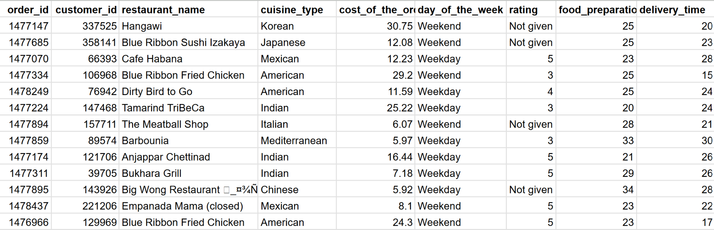
Data Overview
Data Source
foodhub_order.csv
1200 customers
1898 orders
1162 ratings
Size of the Data
1898 rows | 9 cols
178 restaurants
14 cuisines
Online orders made by Foodhub customers

Slide 7
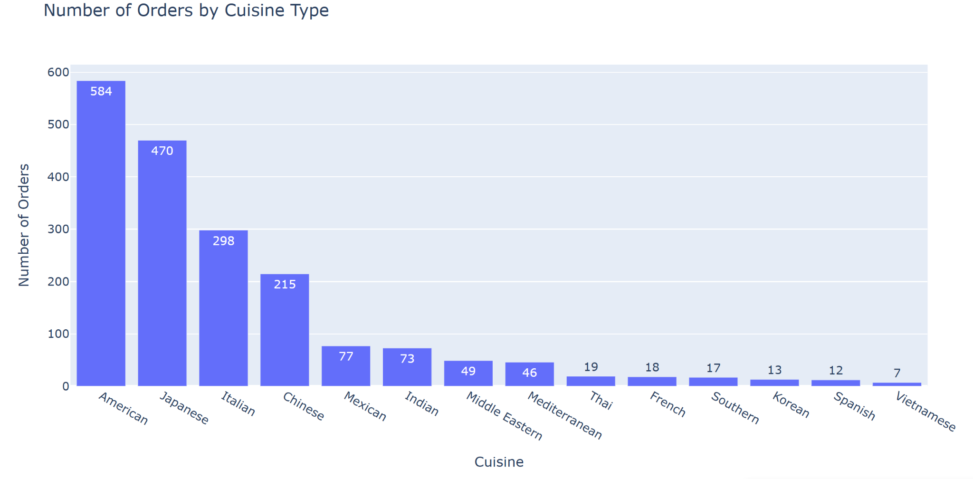
EDA: Cuisine Type
Top 4 Ordered cuisines are: American, Japanese, Italian, and Chinese
Top 4 cuisines make up 82% of total orders
Least ordered cuisine is Vietnamese.
14 Cuisine types

Slide 8
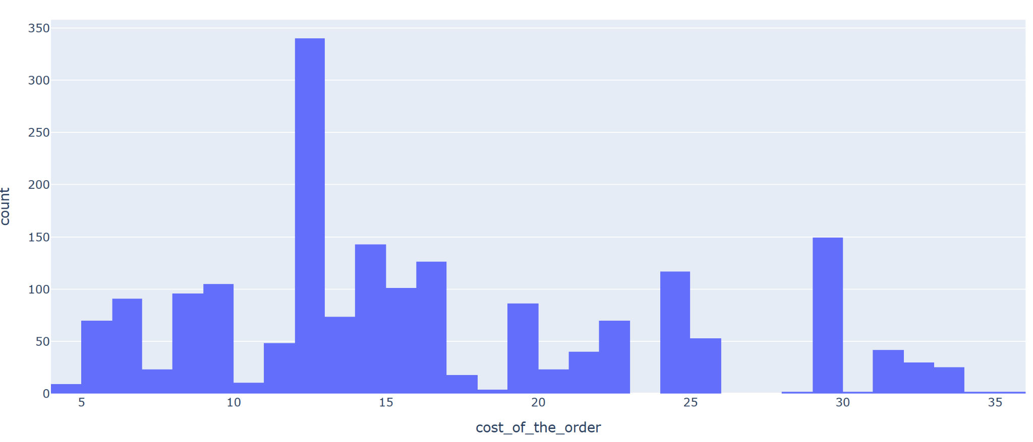
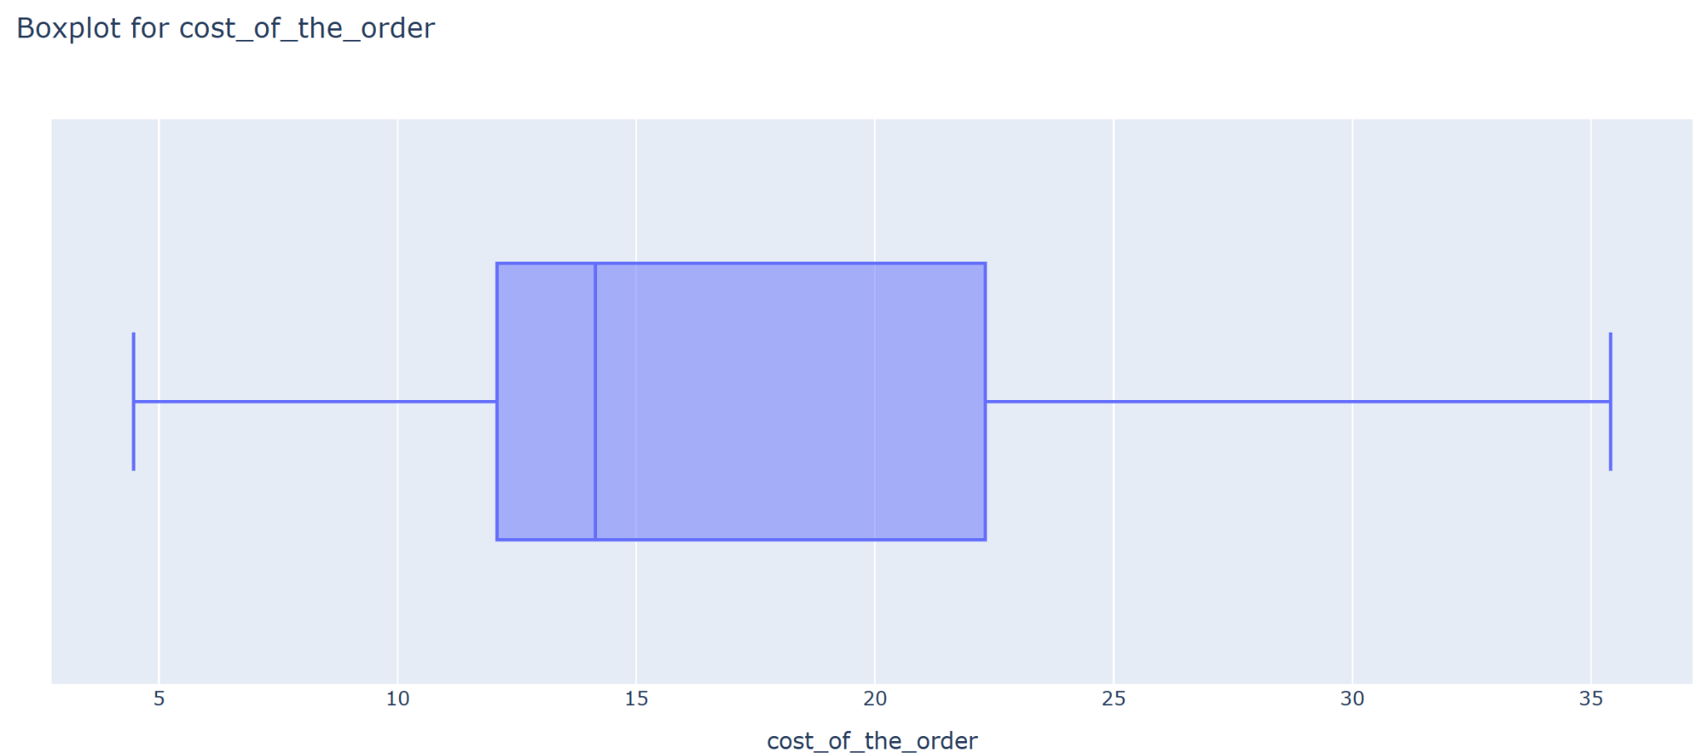
EDA: cost of the order
1898 Orders
Min: $4.47, Max: $35.41
Average: $16.49
Q1: $12.08, Q3: $22.29
Order cost distribution shows a bi-modal pattern.
Median order cost is closer to first quartile indicating right skewed data.

Slide 9
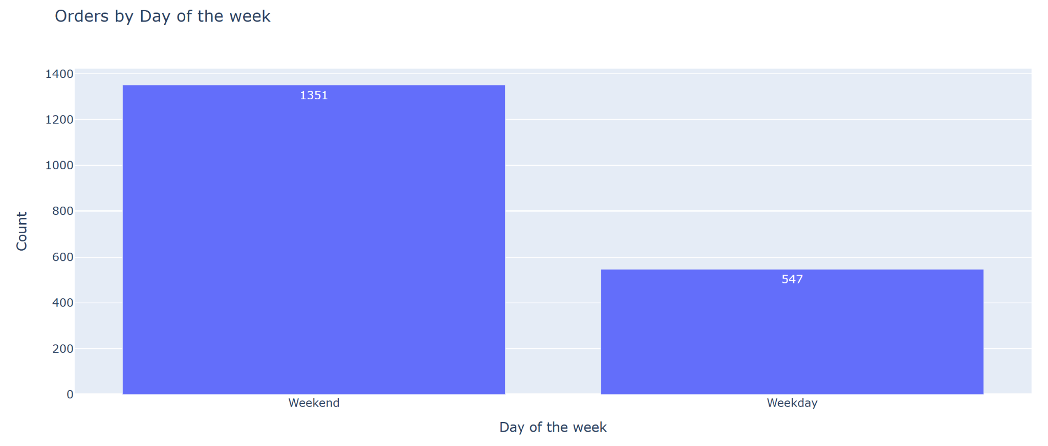
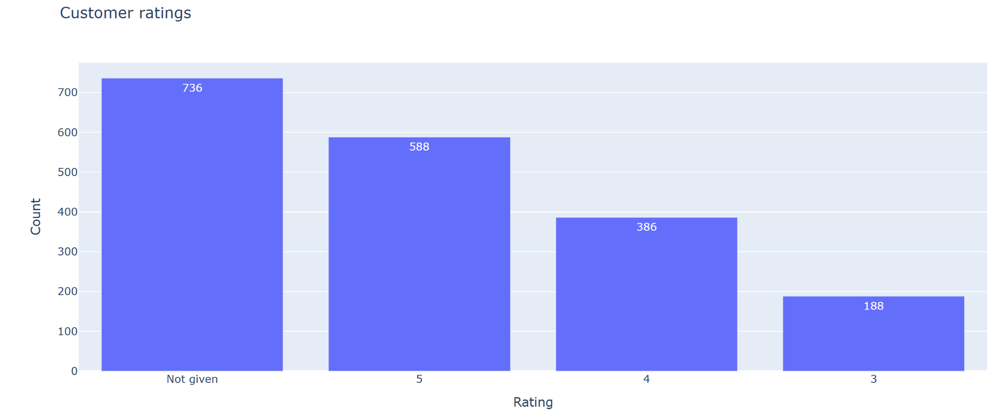
EDA: day of the week
EDA: rating
2 types - Weekday, Weekend
Weekend orders are significantly higher than Weekday orders.
Weekend deliveries make up to 71% of total deliveries.
No. of ratings given: 1162 (~61%)
Ratings not given: 736 (~39%)
Out of 1162 ratings received
50.6% are rated 5 | 33.22% are rated 4 | 16.18% are rated 3
There are no 1 or 2 ratings, possibly indicating the customers that are reasonably satisfied are reviewing, where as dissatisfied customers may not be giving feedback.

Slide 10
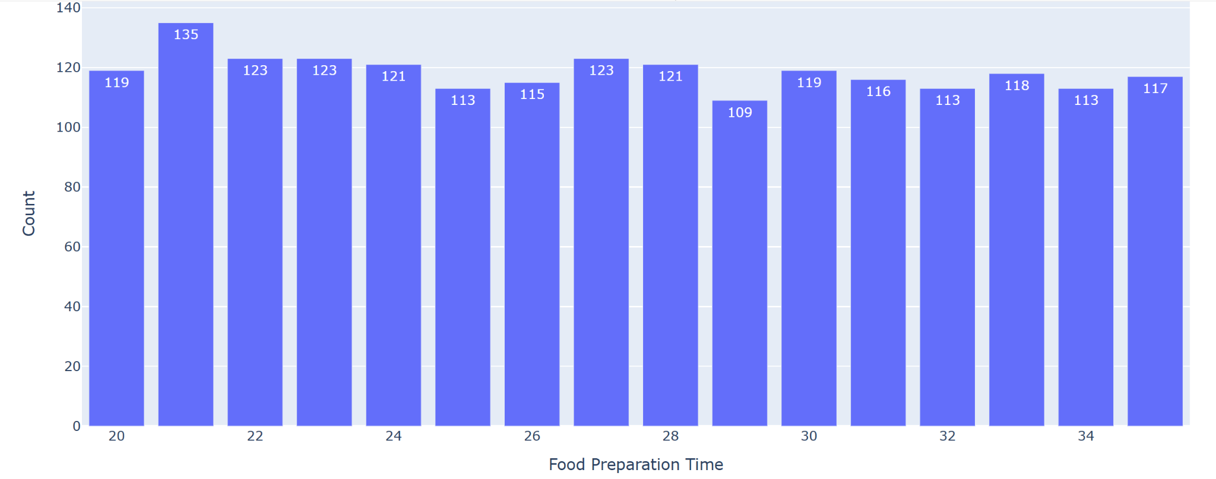
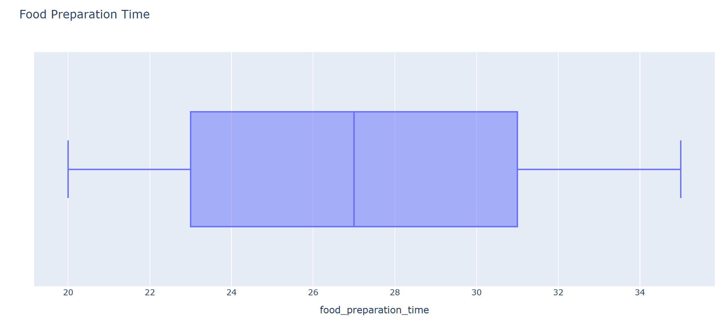
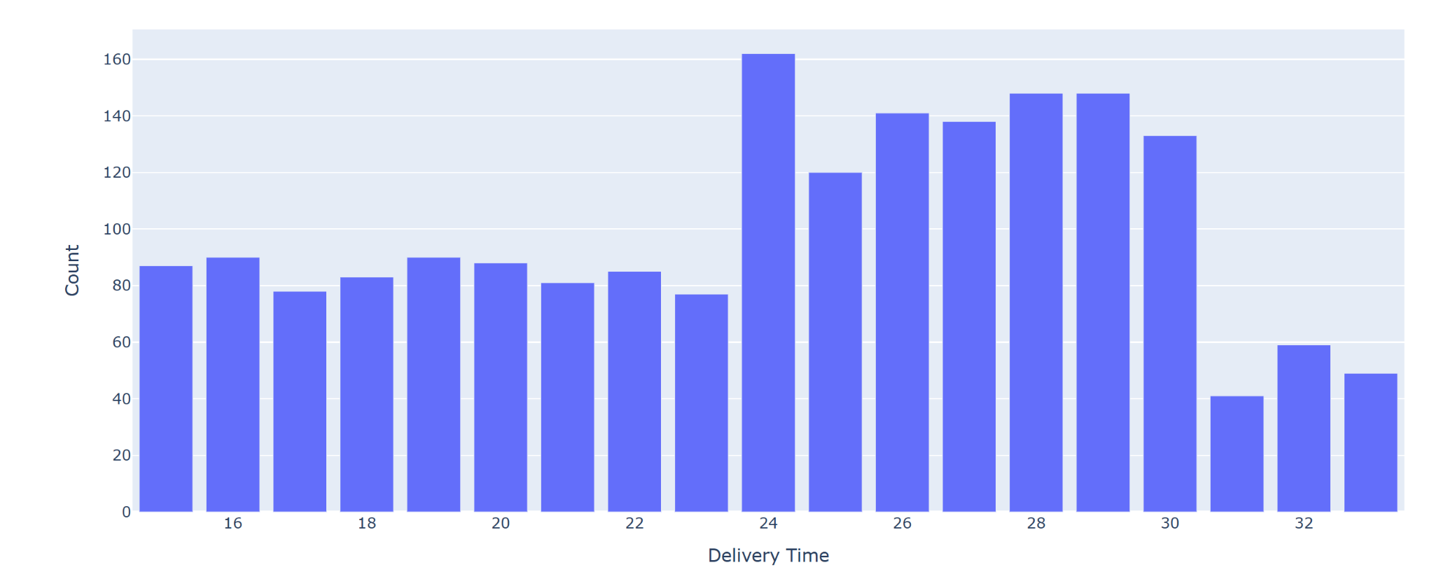
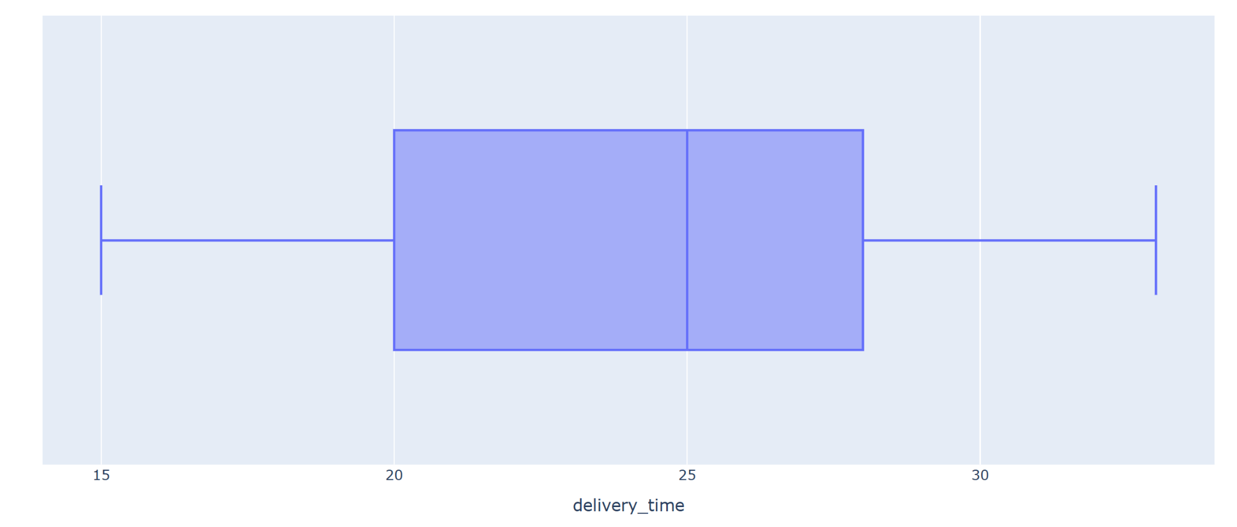
EDA: food preparation time
delivery time
Food preparation time ranges between 20 to 35 mins, with an average time of 27 mins.
The data shows a uniform distribution indicating all outcomes are possible.
Further analysis is required as the preparation time could vary based on factors such as cuisine type, size of the order, restaurant, etc.
Food preparation time ranges between 15 to 33 mins, with an average time of 24 mins.
The data doesn’t show a particular pattern, it's more of a uniform distribution indicating all outcomes are possible.
Further analysis is required as the delivery time could vary based on factors such as traffic, weather conditions, how far the restaurant is from customer address, etc.

Slide 11
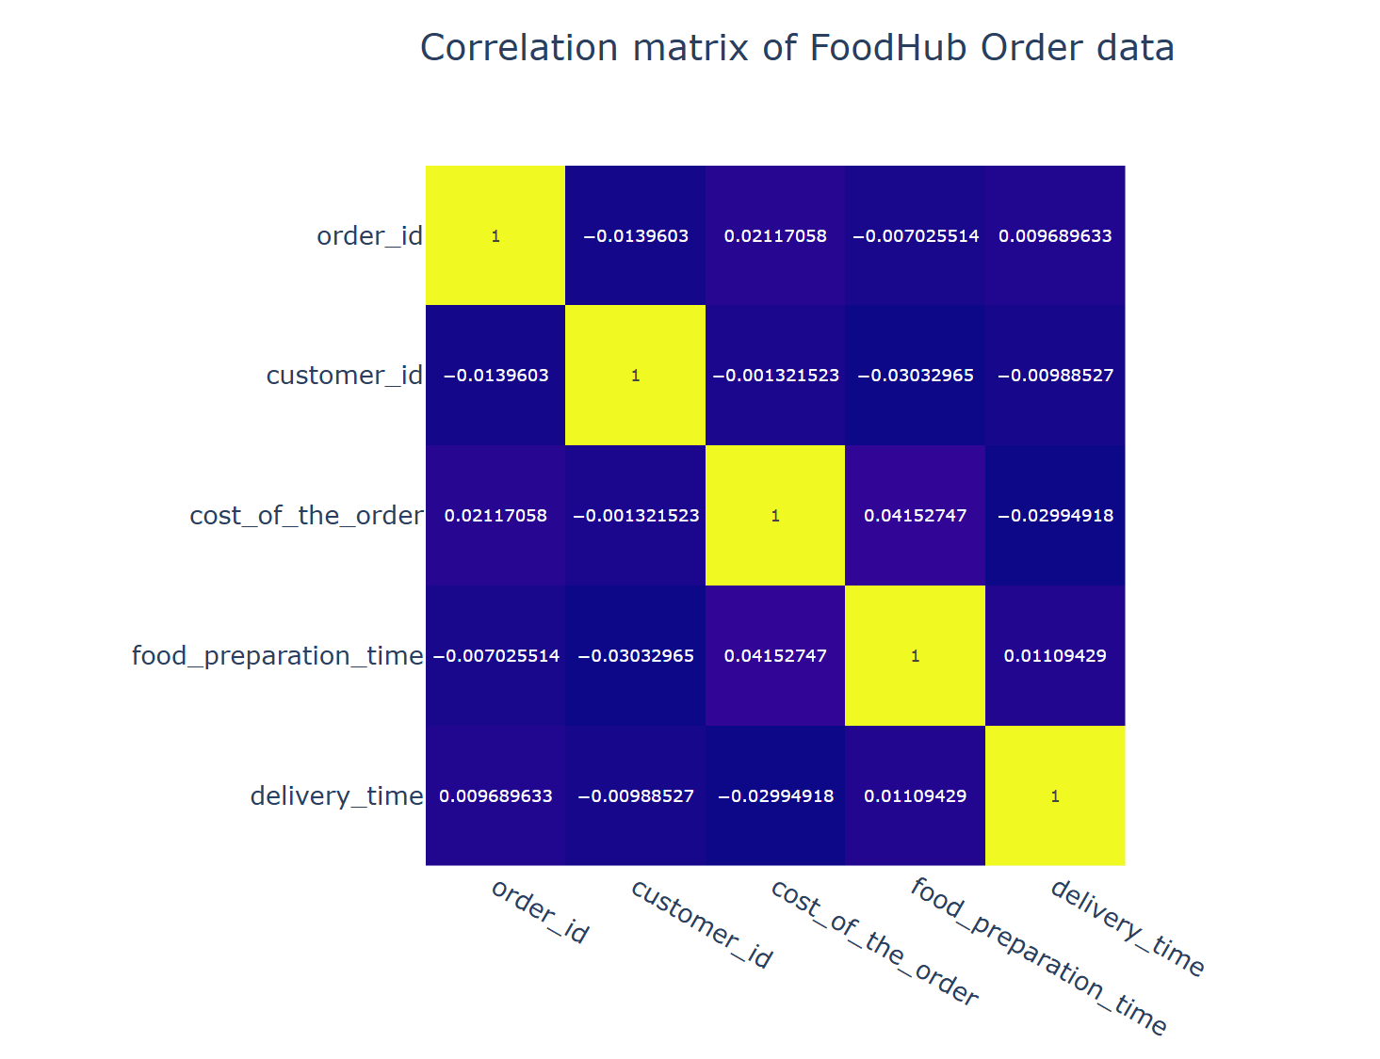
EDA: Correlation of numeric variables
The heat-map doesn’t show strong correlation between variables.
Customer id and Order id are identifiers and have no effect on any other outcomes.
The food preparation and delivery times may affect customer experience and reflect in ratings.
Need further analysis of the data.

Slide 12
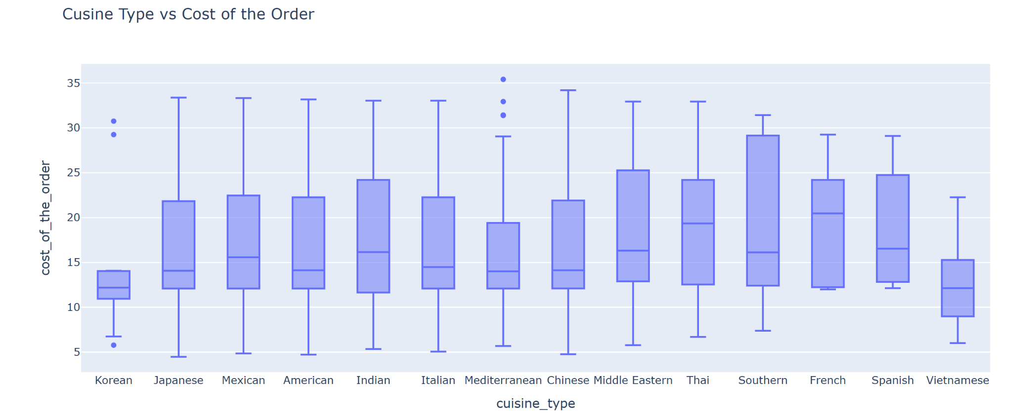
EDA: Cost vs Cuisine Type
The max cost of the order is in the range of $30 to $35 for most of the cuisines.
Korean and Mediterranean orders have some outliers of the cost.
Korean cuisine third quartile and max cost are almost same.
French and Spanish first quartile and min costs are very close.
Other than Thai and French, most of the cuisines data is right skewed.

Slide 13
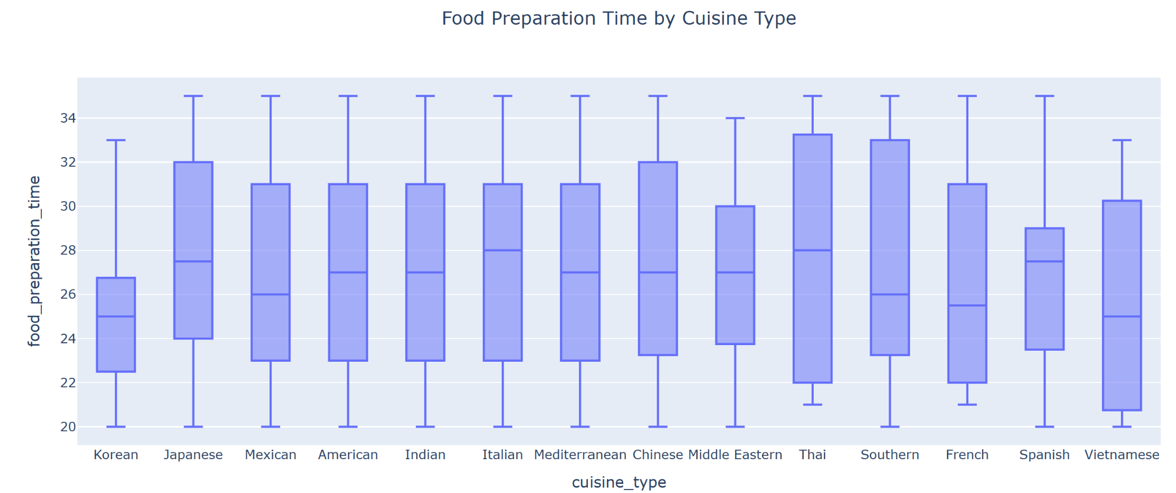
EDA: Food preparation time vs Cuisine Type
The median food preparation time varies with cuisine type.
There are no outliers in the data.
All cuisines have max preparation times 30 mins or above.
Except Thai and French, the minimum preparation time for all cuisines is about 20 mins.

Slide 14
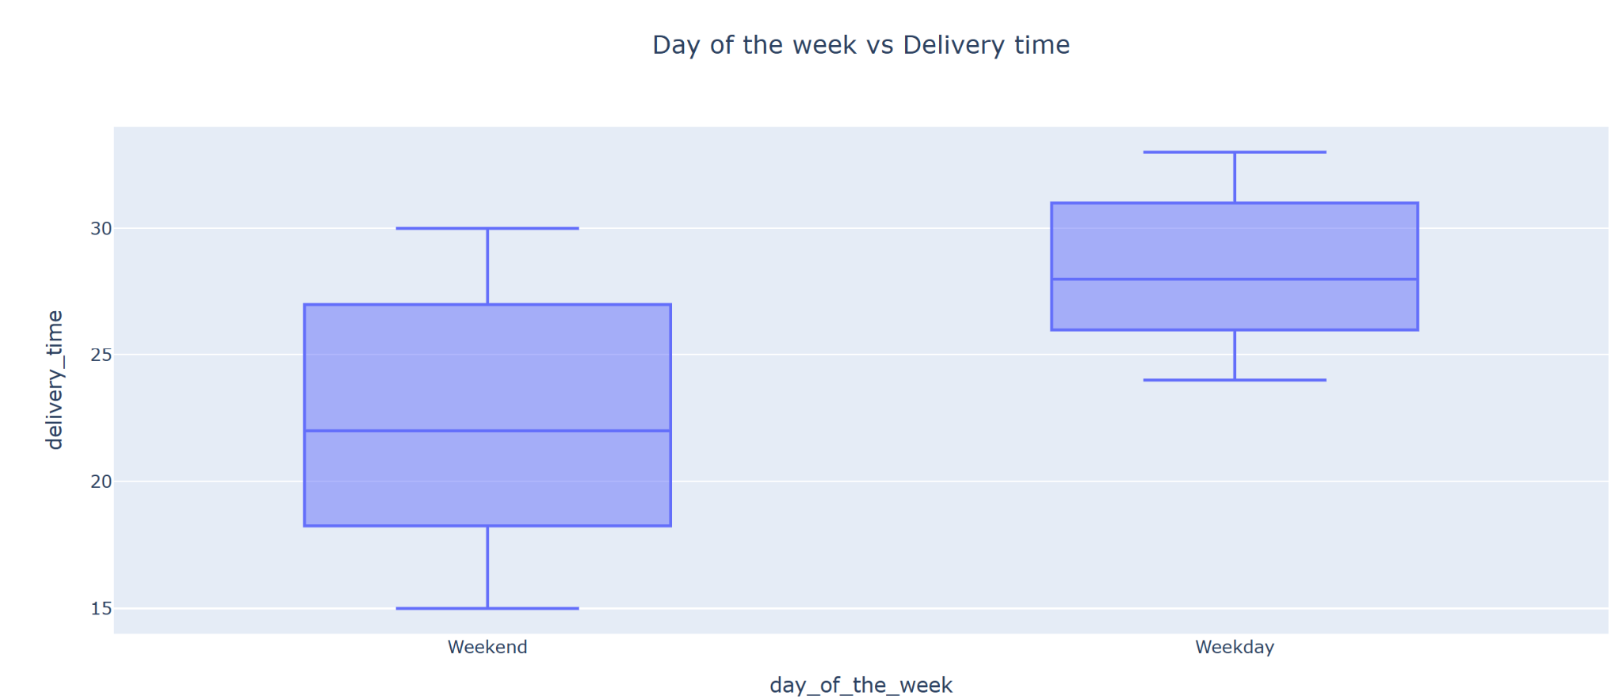
EDA: Day of the week vs Delivery Time
There are no outliers in the data.
The Weekend deliveries are faster than the Weekday deliveries.
The median delivery time on a weekend is around 22 mins, where as its around 28 mins on Weekdays.
75% of the Weekend deliveries are faster than a median delivery on Weekdays.
The minimum delivery time on a Weekday is higher than the median delivery time oon a Weekend.

Slide 15
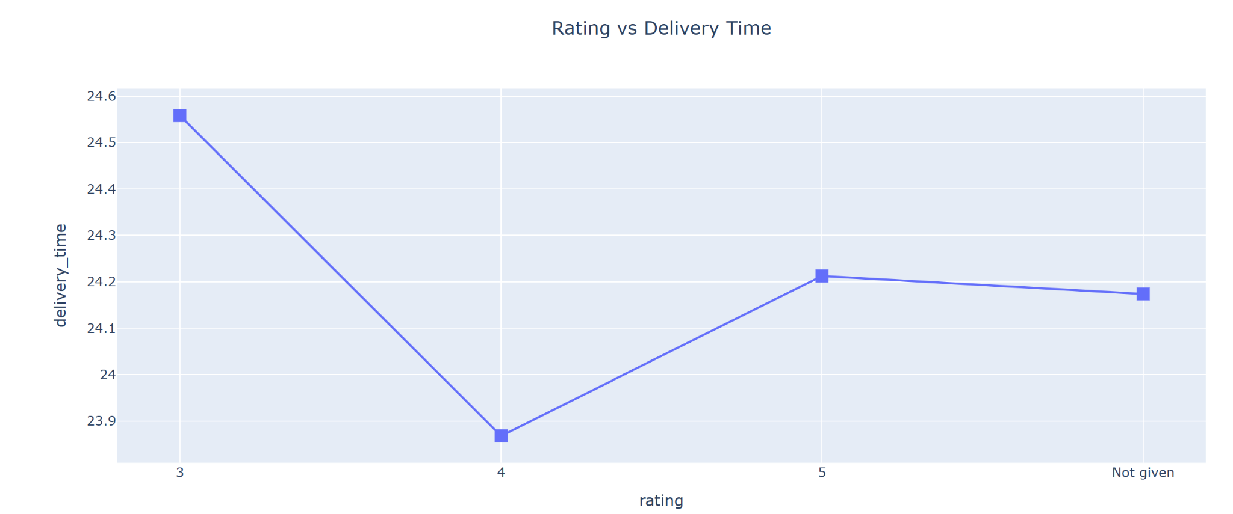
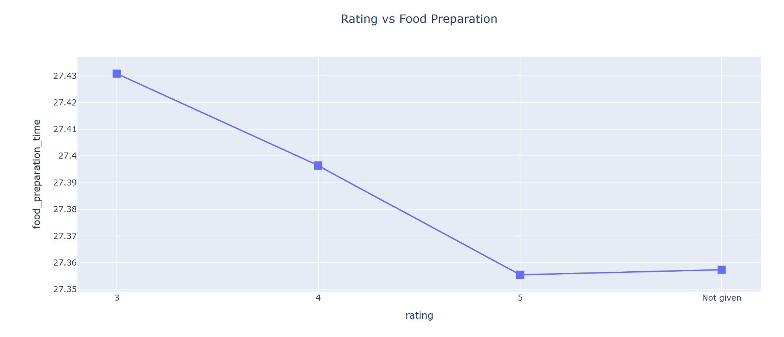
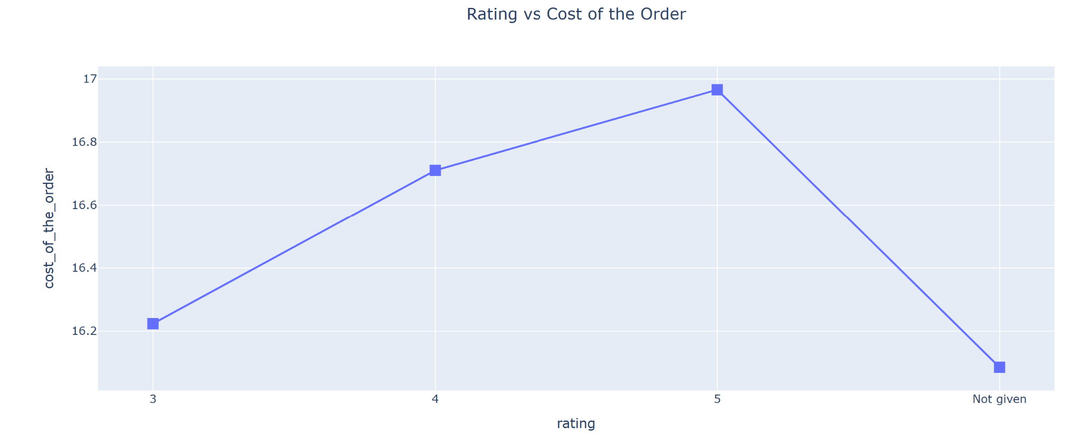
EDA: Rating vs delivery time, food preparation time and cost of the order
Rating vs Delivery Time
Doesn’t show a linear correlation.
This possibly indicates factors outside the delivery time affect the customer rating.
Rating vs Food Preparation Time
Although shows a negative correlation, the difference in timings are not that significant.
This possibly indicates factors outside the food prep time affect the customer rating.
Rating vs Cost of the order
Show a positive correlation.
This possibly indicates customers may be willing to pay a higher price for a good service.

Slide 16
EDA: Key Observations
Total Restaurants: 178 | Cuisines : 14 | Customers: 1200
Orders: 1898 | Ratings given: 1162 | Not given: 736 | Net Revenue: $6166.3
Top Rated Restaurants: The Meatball Shop (4.51), Blue Ribbon Fried Chicken (4.32), Shake Shack (4.27), Blue Ribbon Sushi (4.21)
Top 5 restaurants with most orders received: Shake Shack , The Meatball Shop, Blue Ribbon Sushi, Blue Ribbon Fried Chicken, Parm. Together they received 634 ie. 33% of total orders.
Weekend Orders: 1351 (71%) | Weekday Orders: 547 (29%)
Most popular cuisines on a weekend: American, Japanese, Italian, Chinese, Mexican
Total Orders are for the most popular cuisines : 82.56%
Number of Orders with more than $20 cost: 555 Orders, 29.24% of total orders.
The average delivery time for this data set: 24.16 minutes
The most frequent customers (Id): 52832 (13 Orders), 47440 (10), 83287 (9), 250494 (8), 259341(7)
Restaurants with an avg rating more than 4 and with at least 50 ratings : Shake Shack , The Meatball Shop, Blue Ribbon Sushi, Blue Ribbon Fried Chicken, RedFarm Broadway.
Net Revenue: $6166.3 from 1898 Orders
Percentage of Orders that take more than 60 mins from the time Order placed: 10.54%

Slide 17
APPENDIX

Slide 18
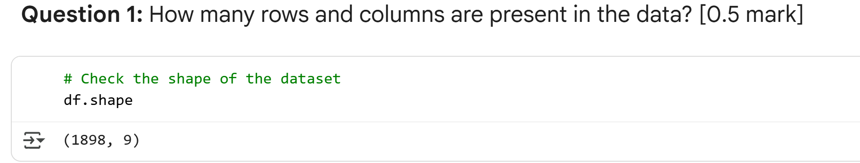
Questions - Used for Data Analysis

Slide 19
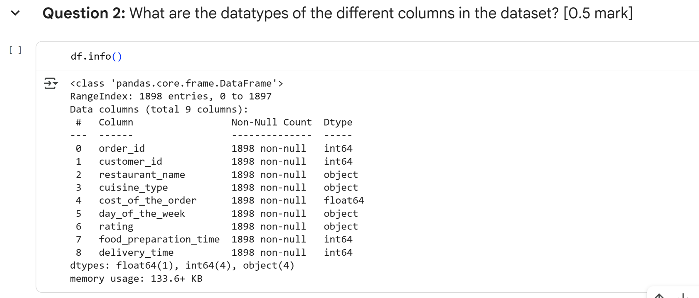

Slide 20
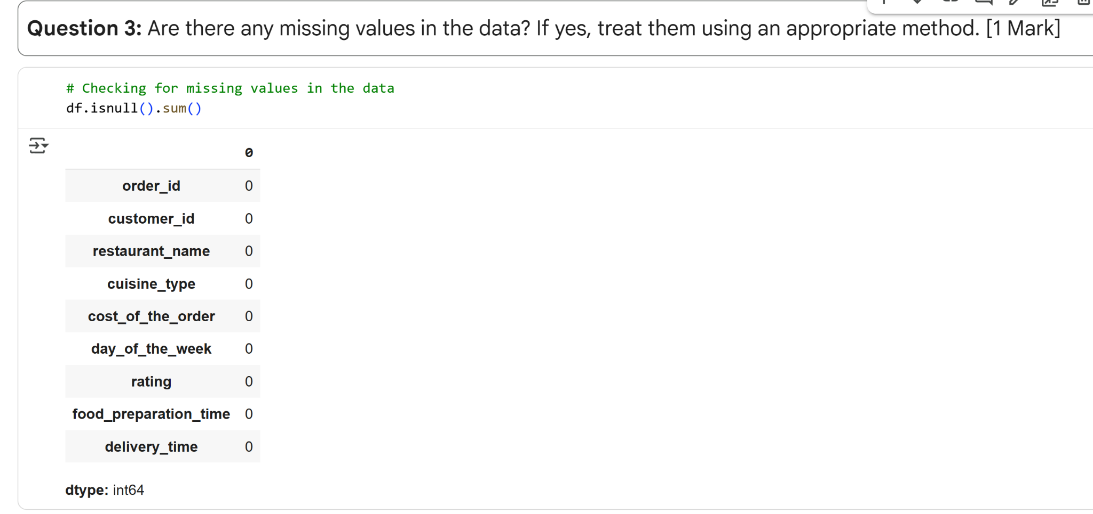

Slide 21
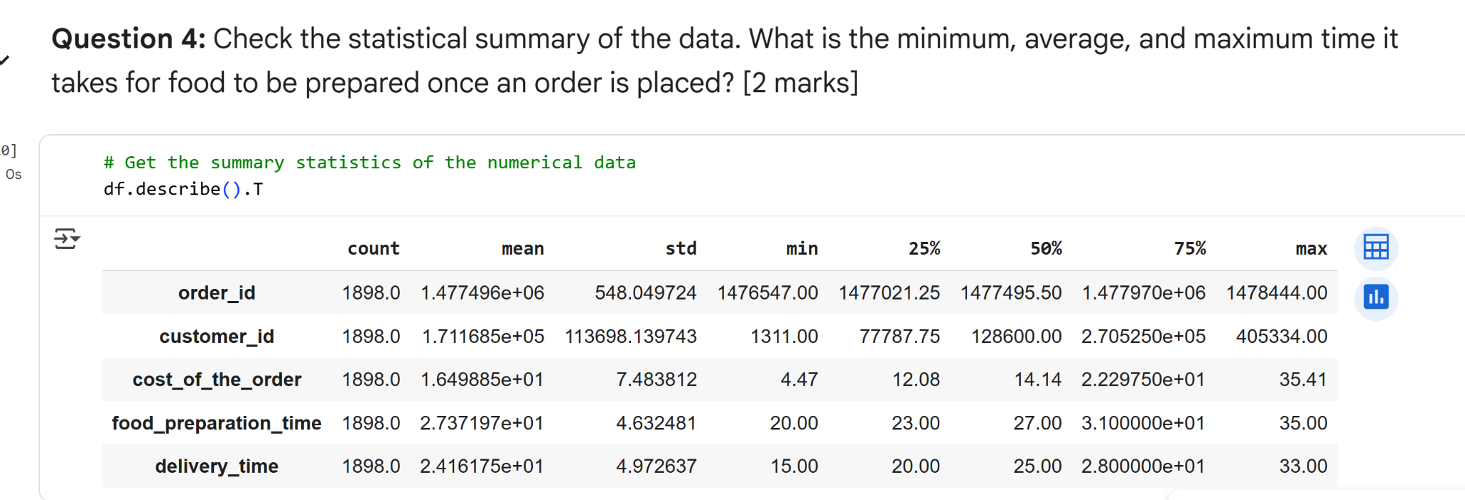

Slide 22
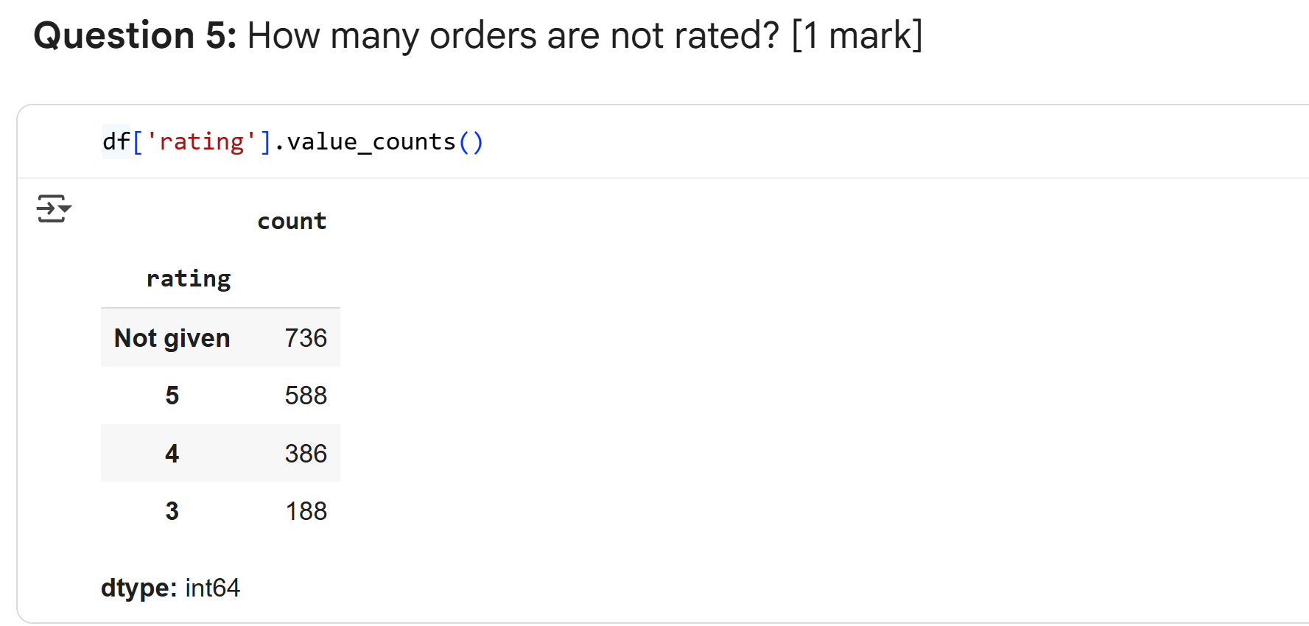

Slide 23
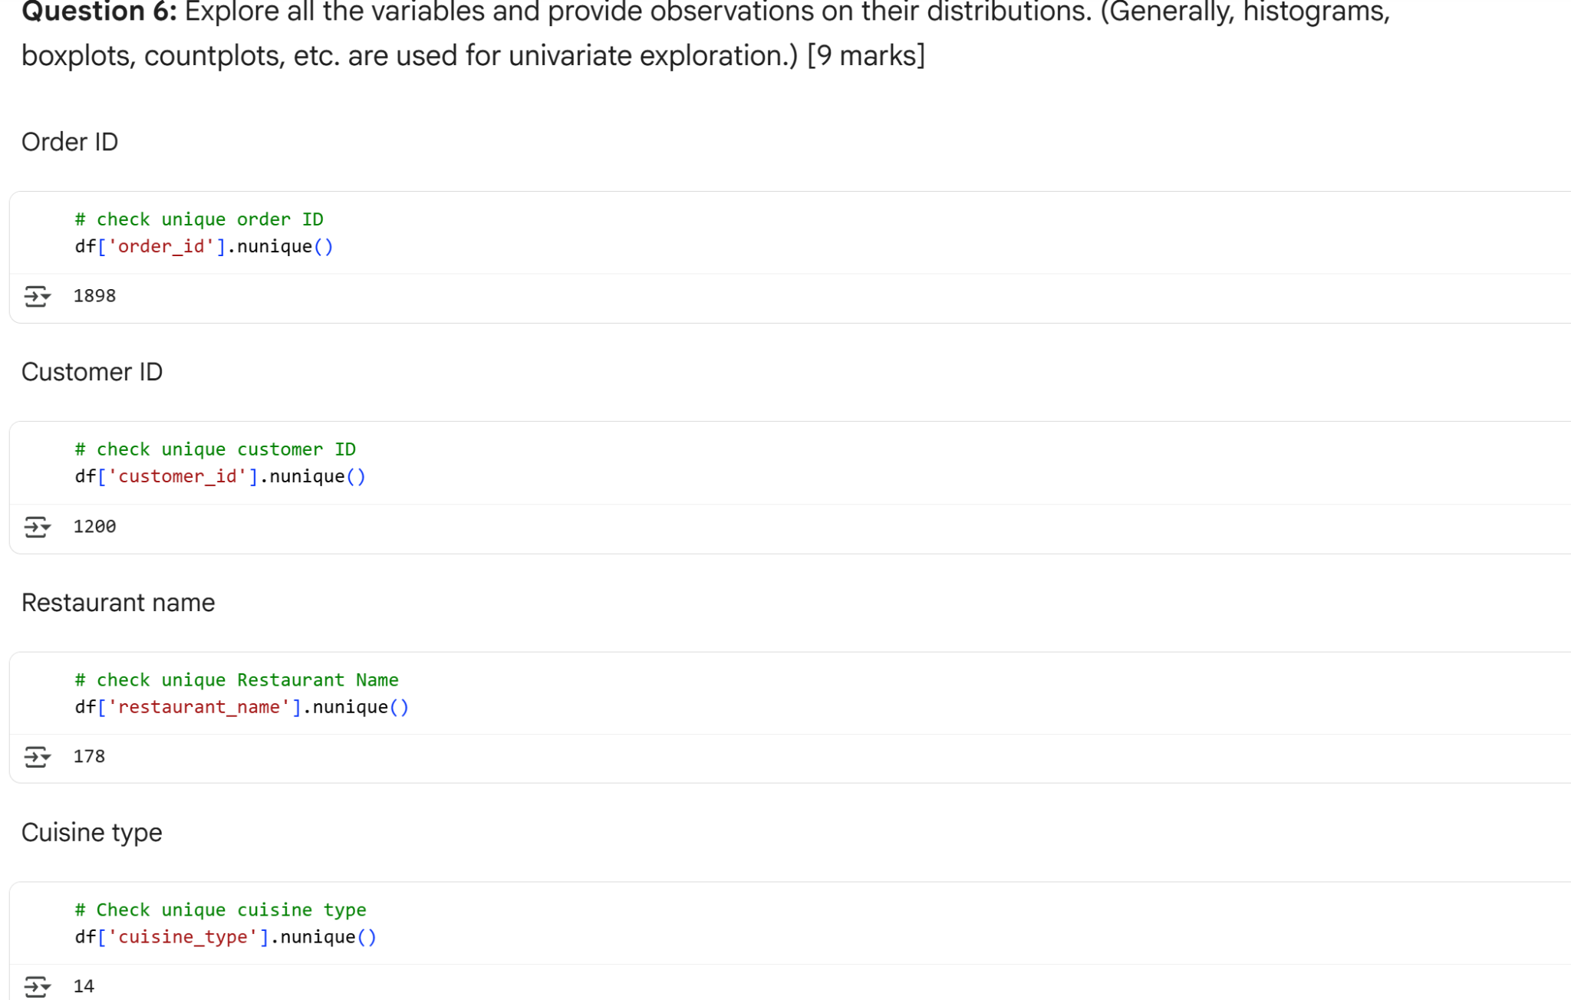

Slide 24
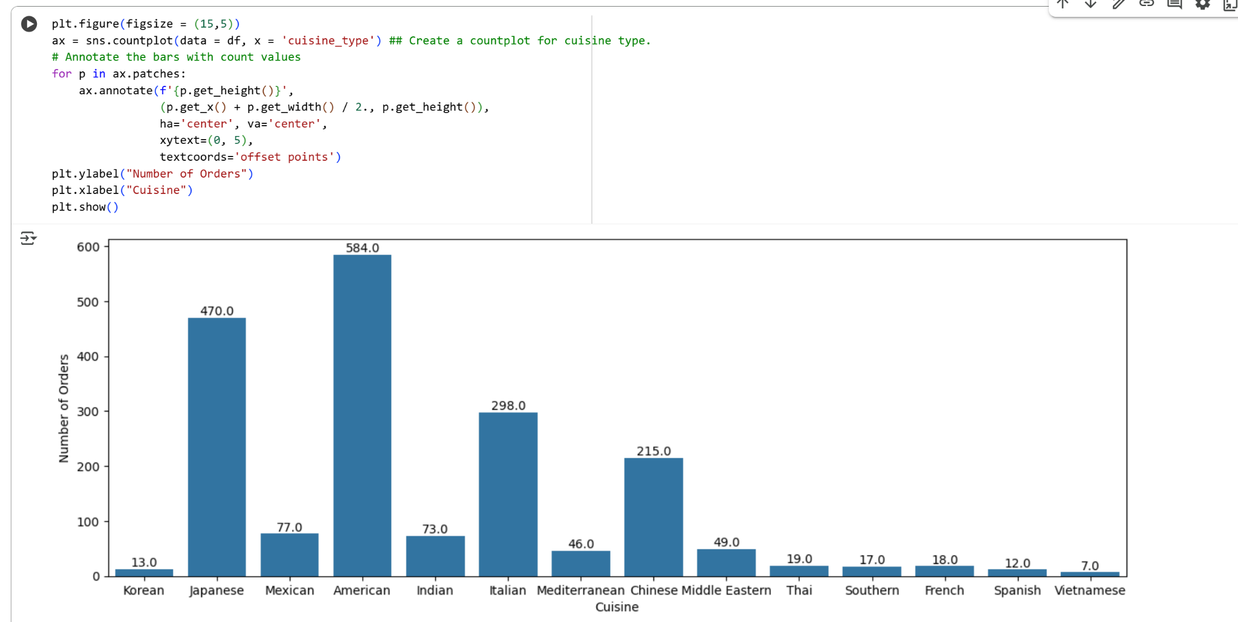

Slide 25
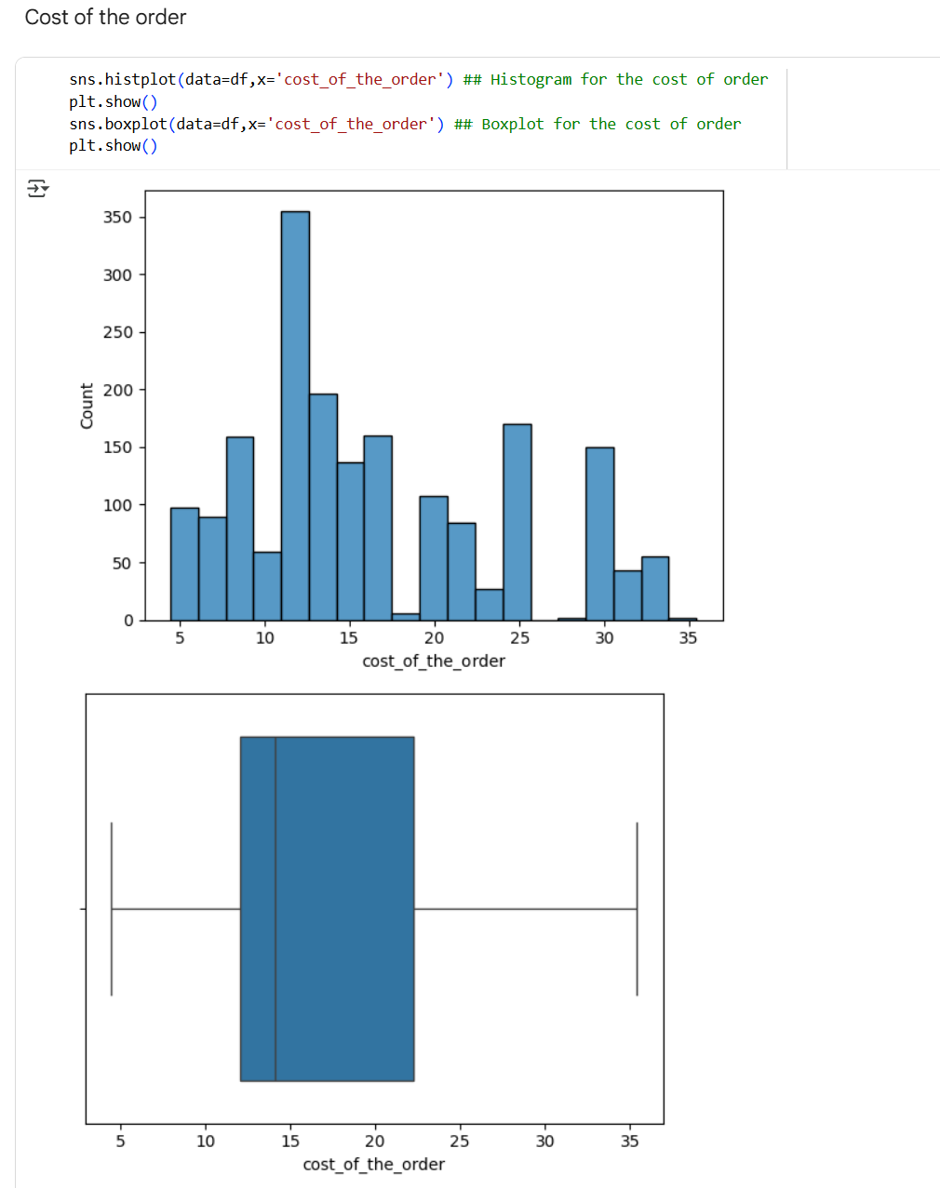

Slide 26
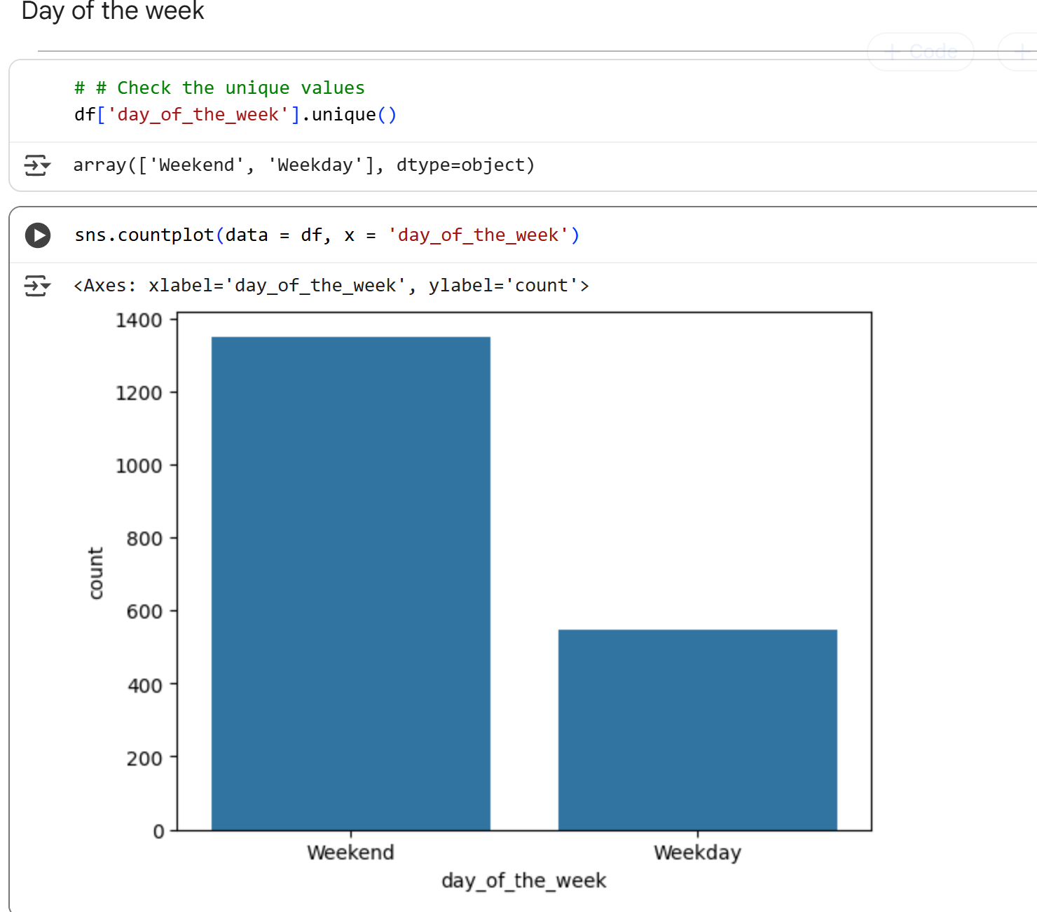

Slide 27
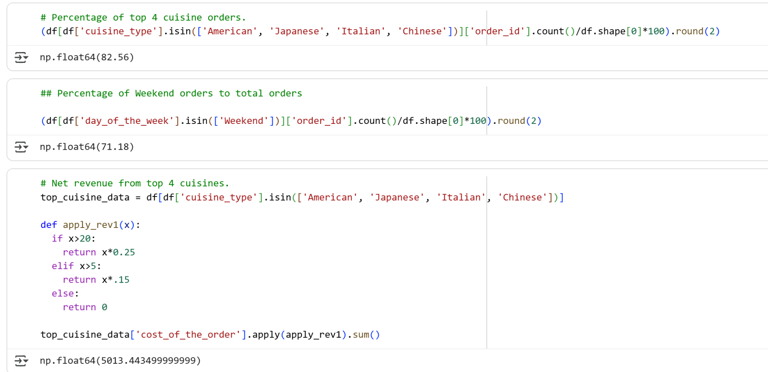

Slide 28
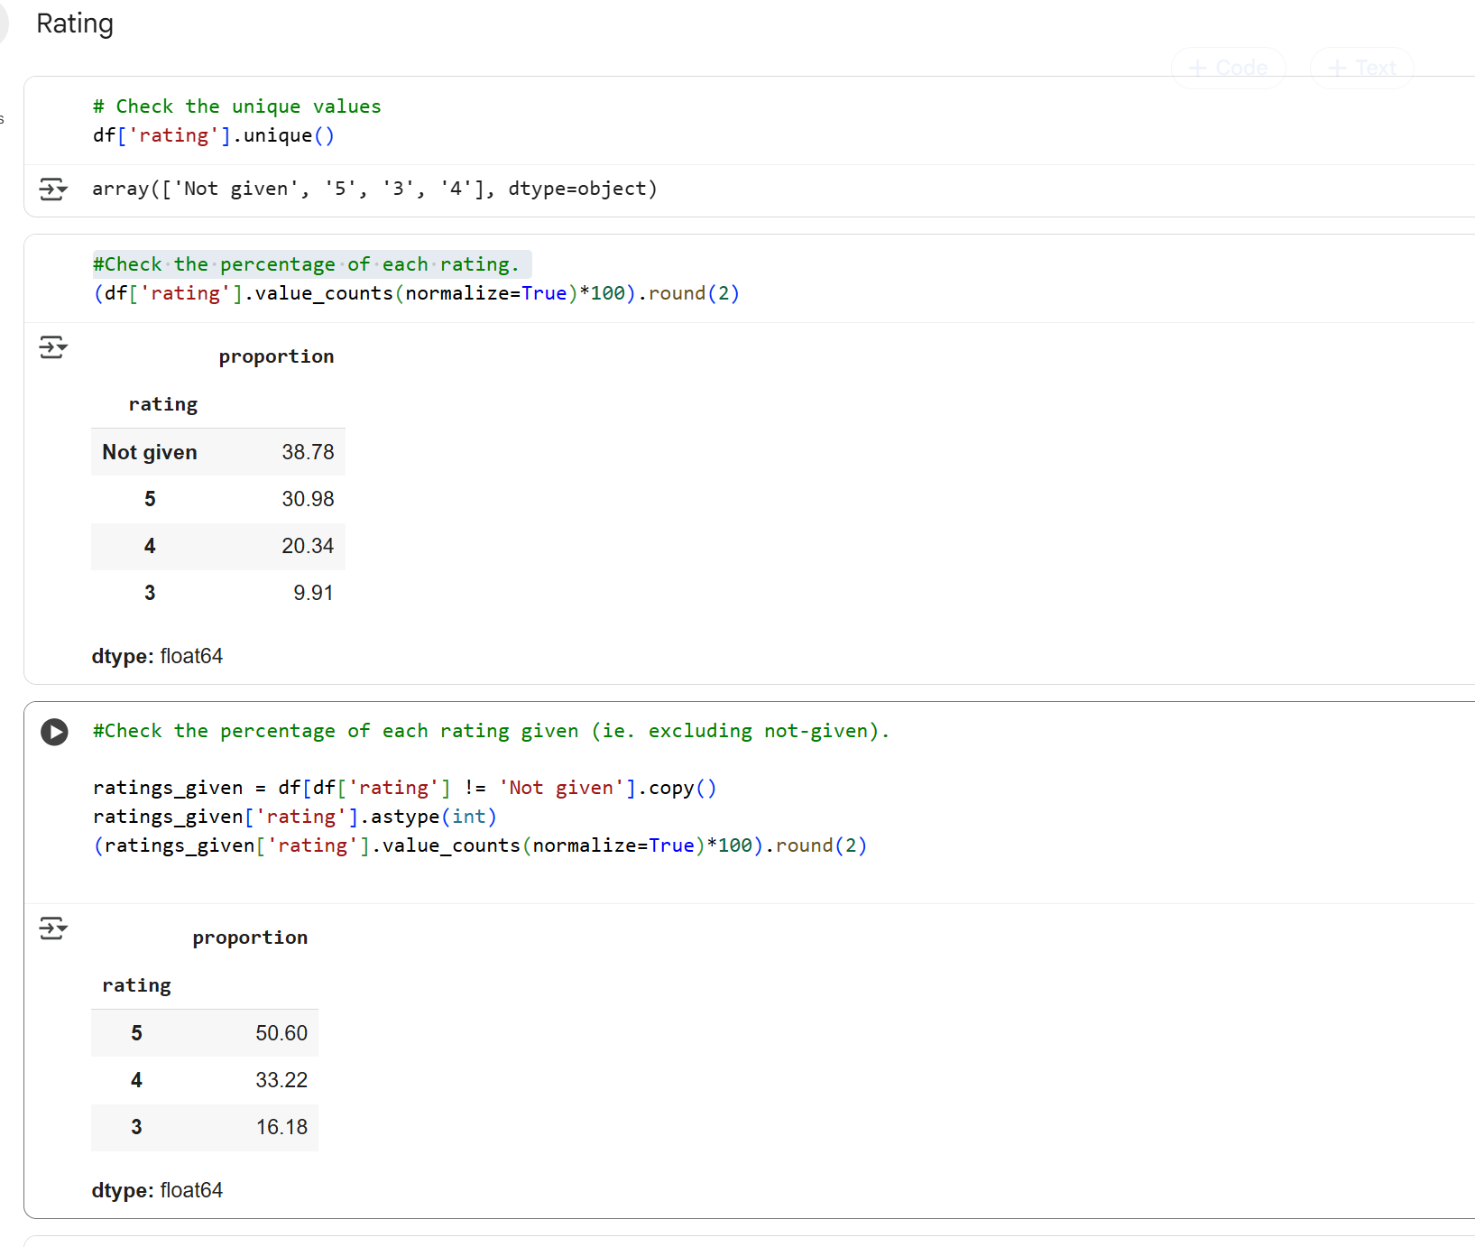

Slide 29
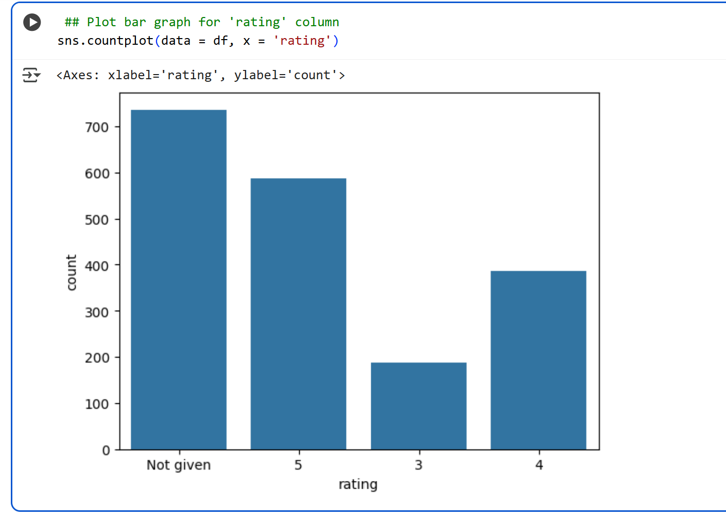

Slide 30
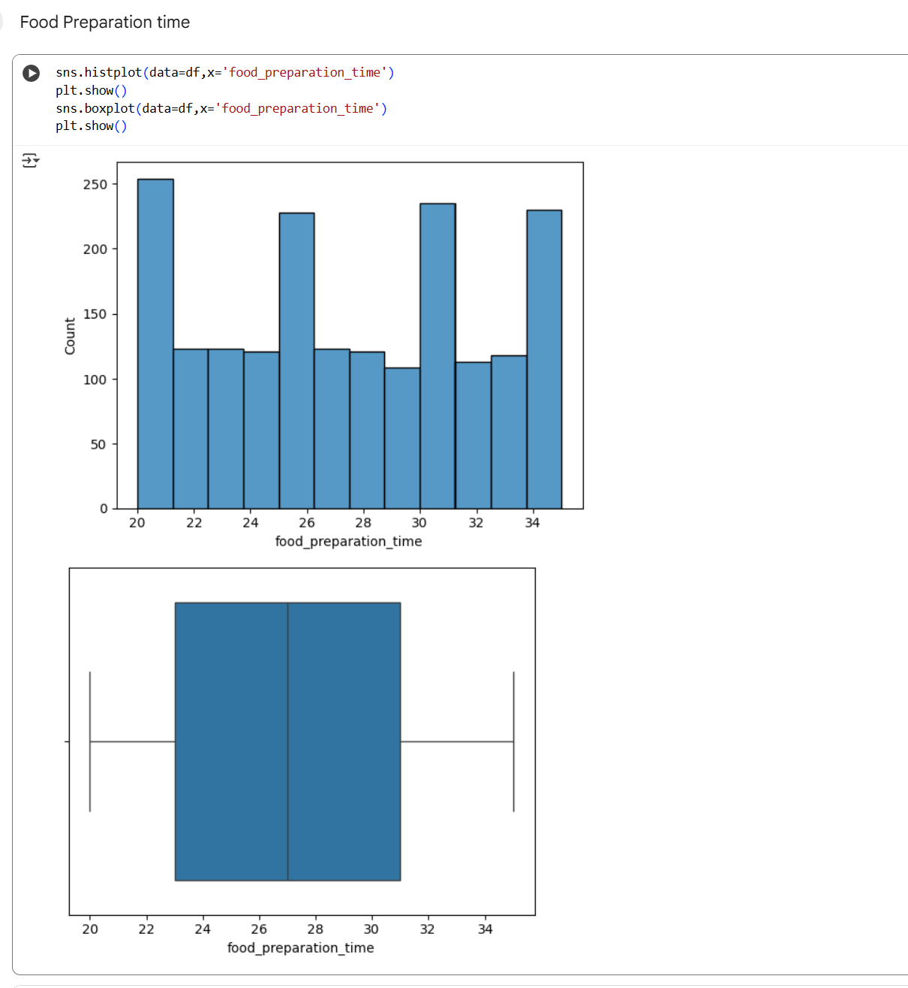

Slide 31
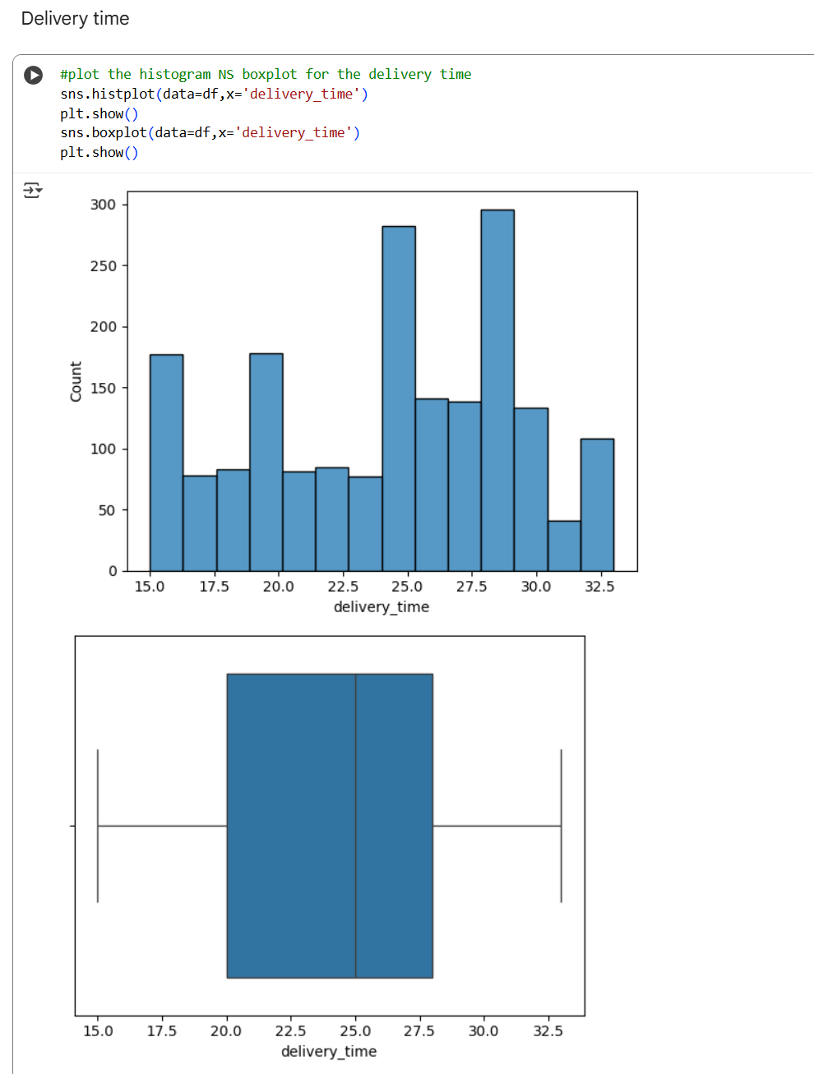

Slide 32
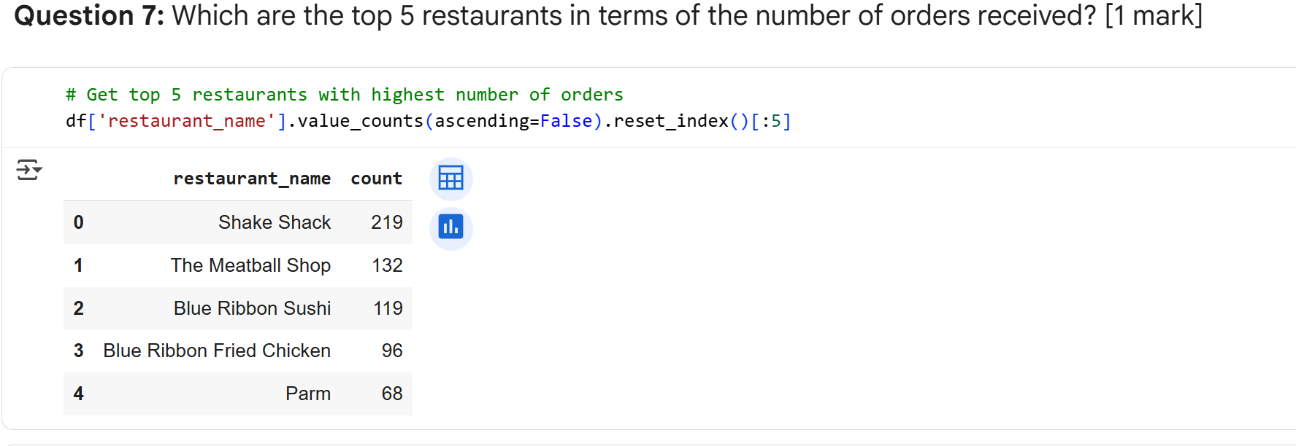

Slide 33
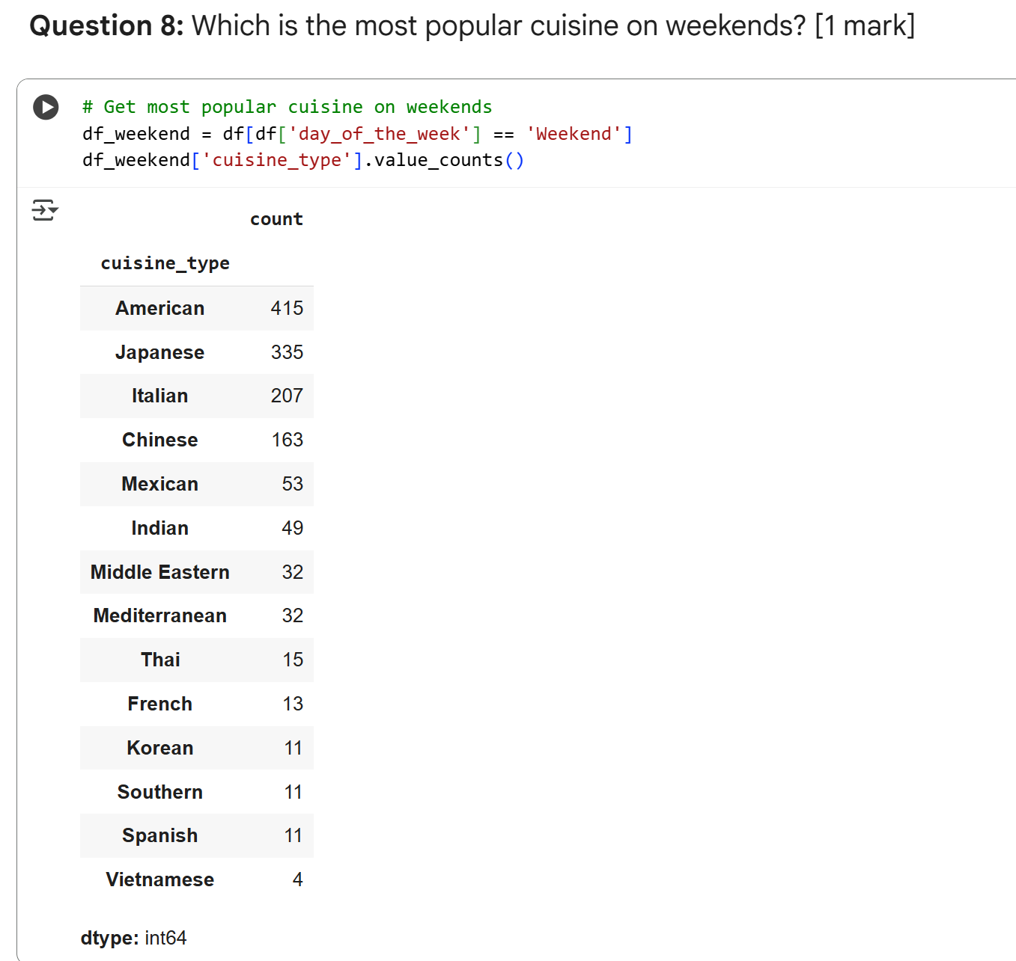

Slide 34
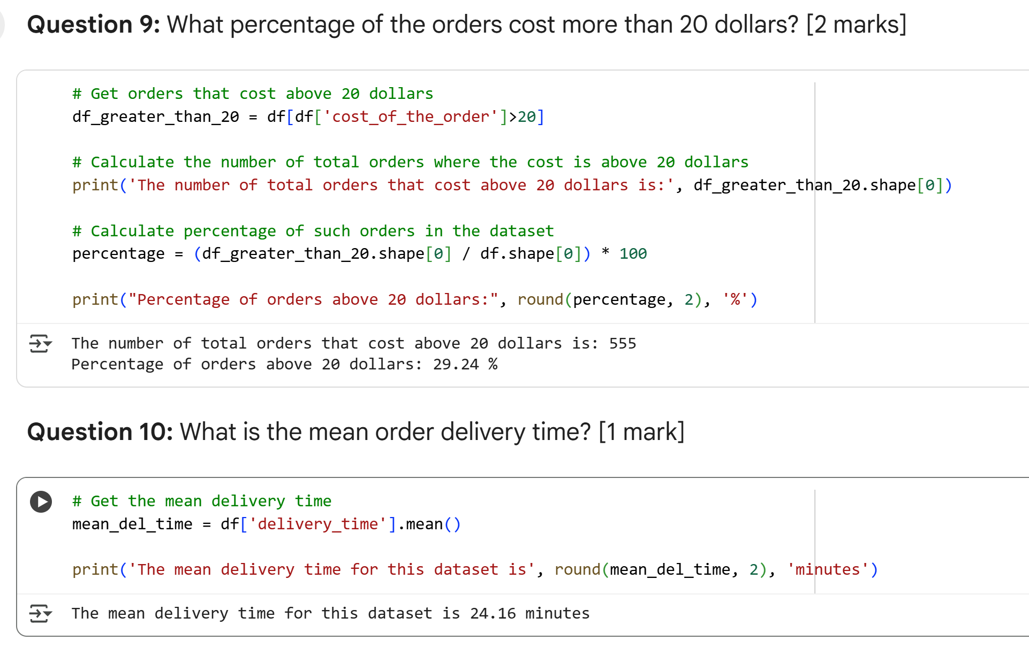

Slide 35
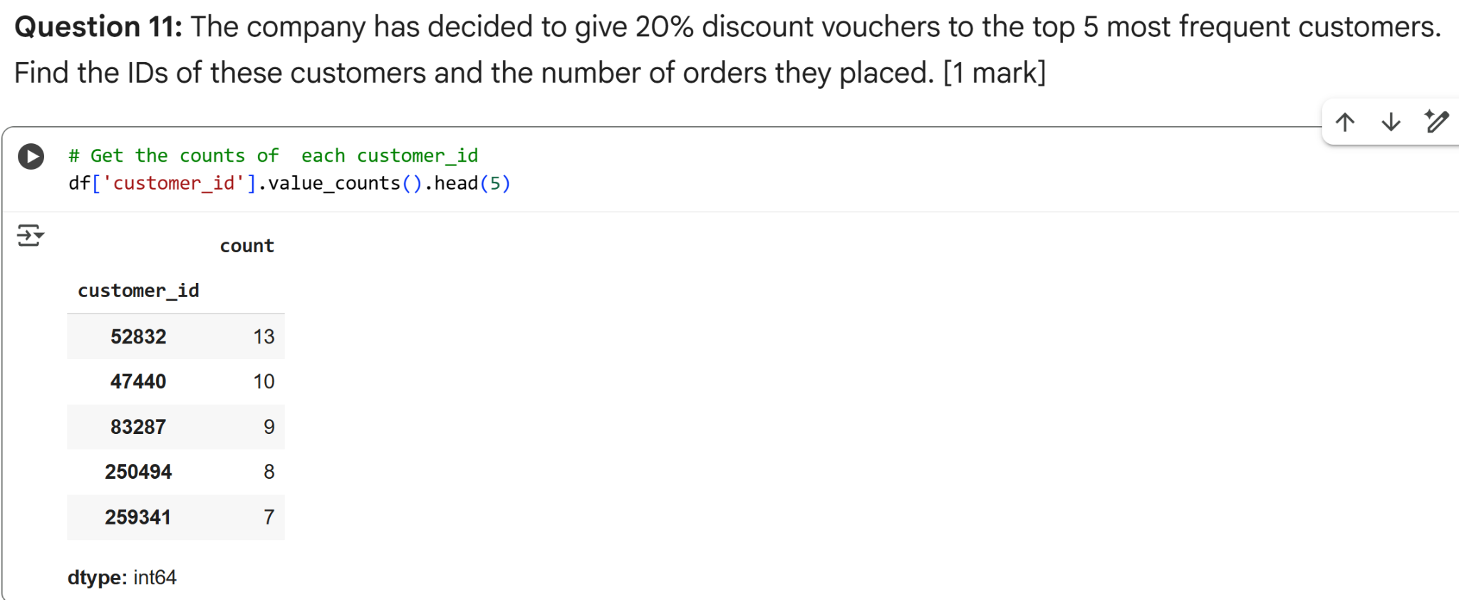

Slide 36
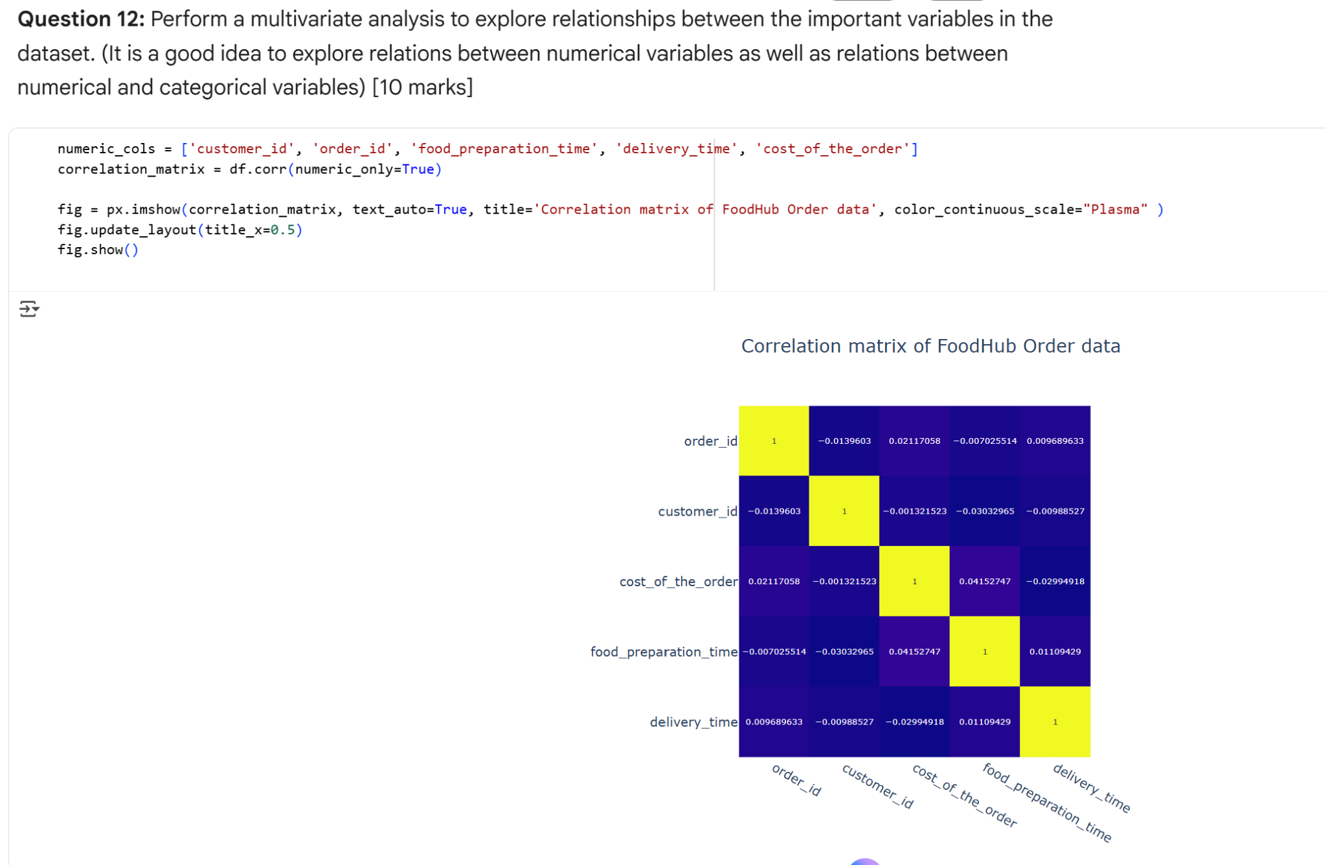

Slide 37
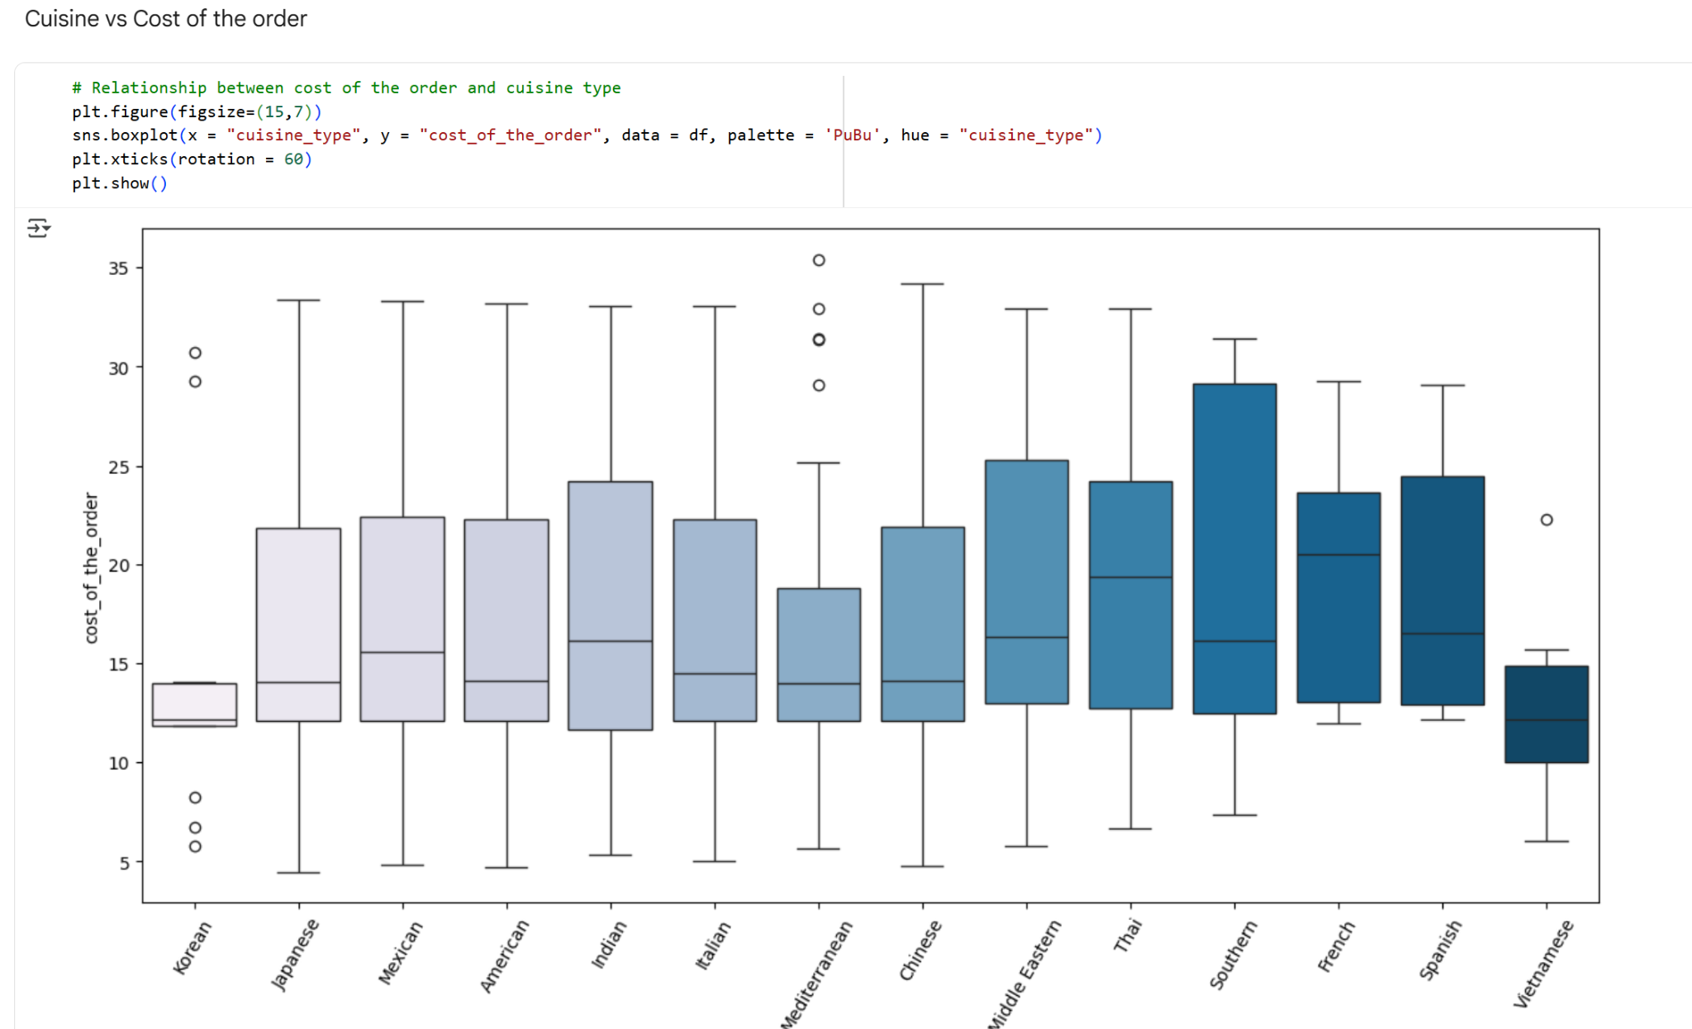

Slide 38
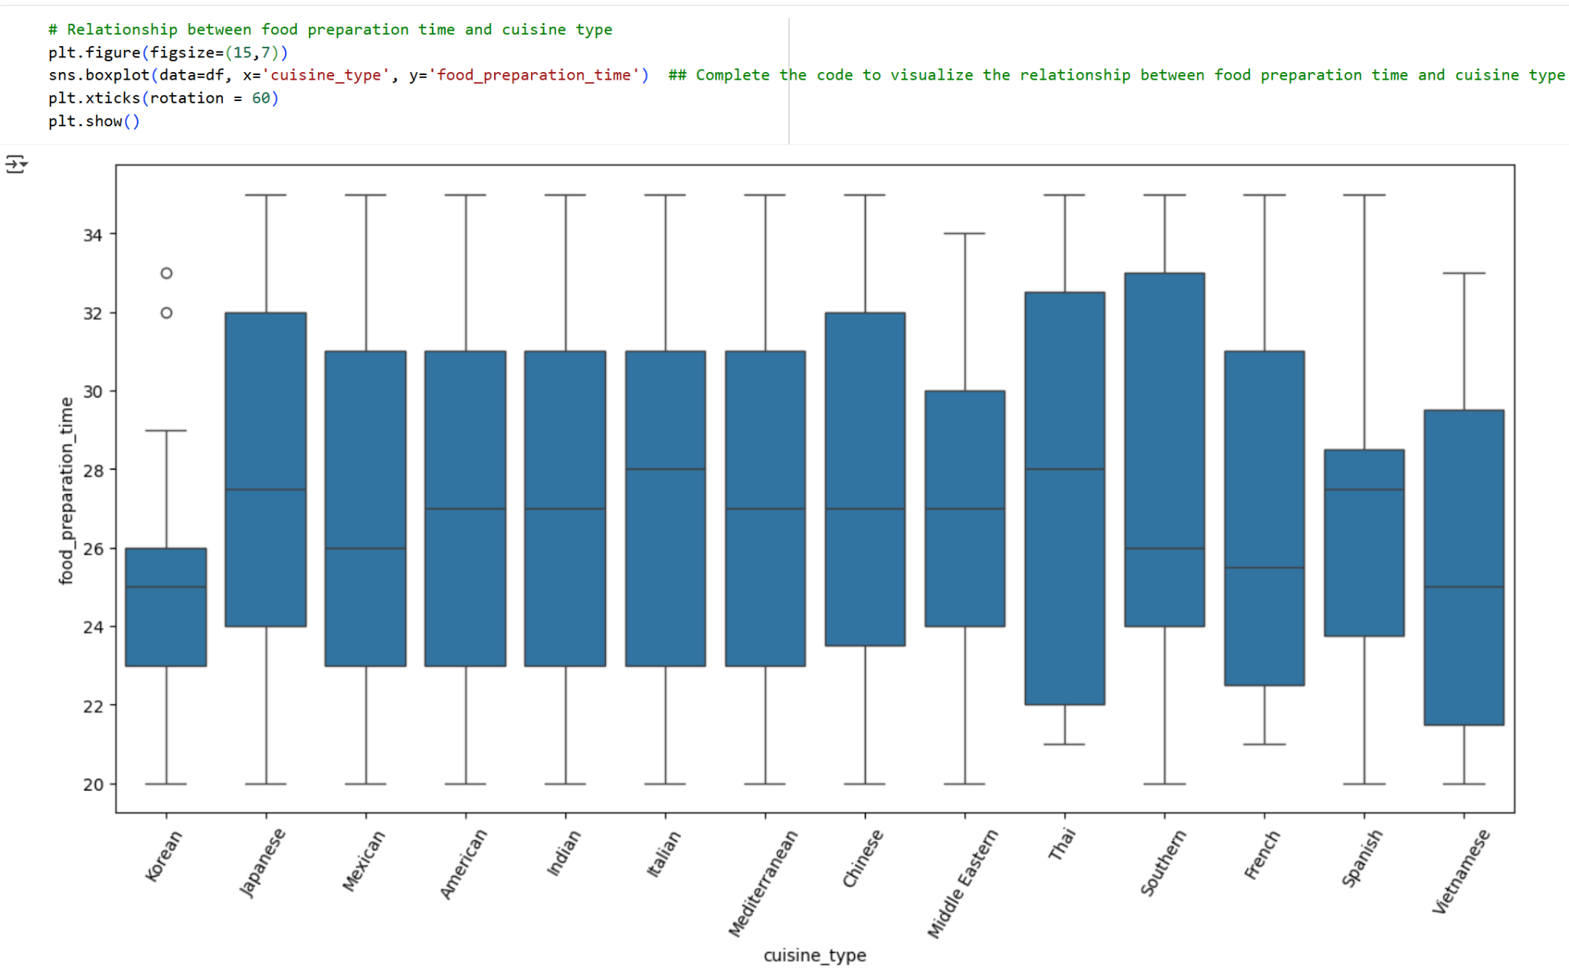

Slide 39
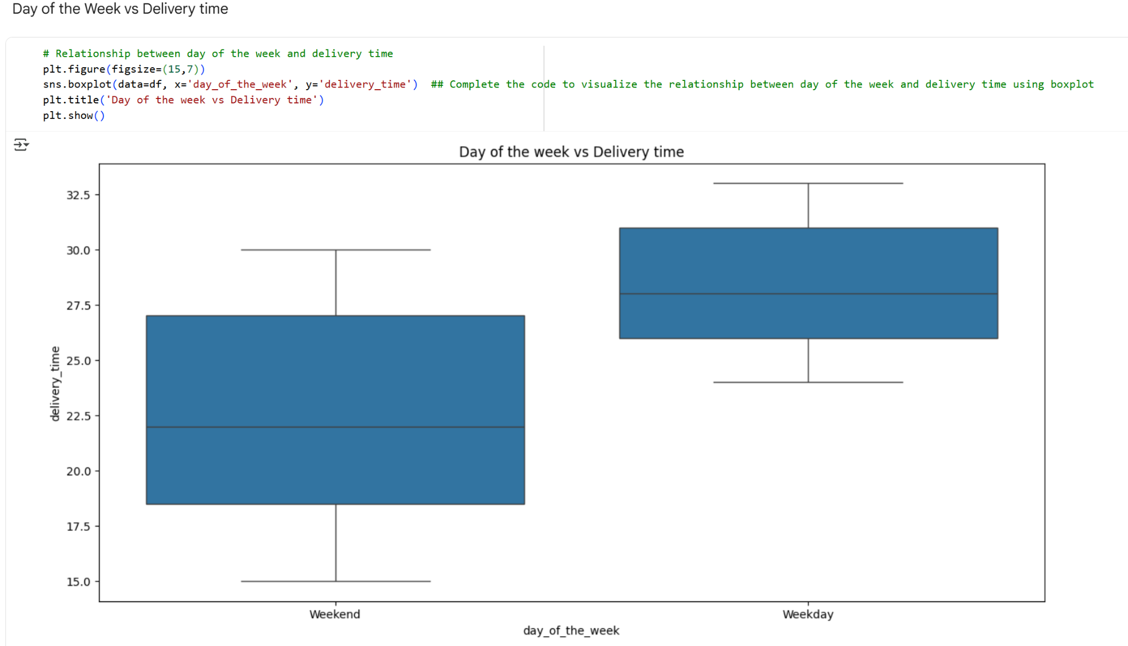

Slide 40
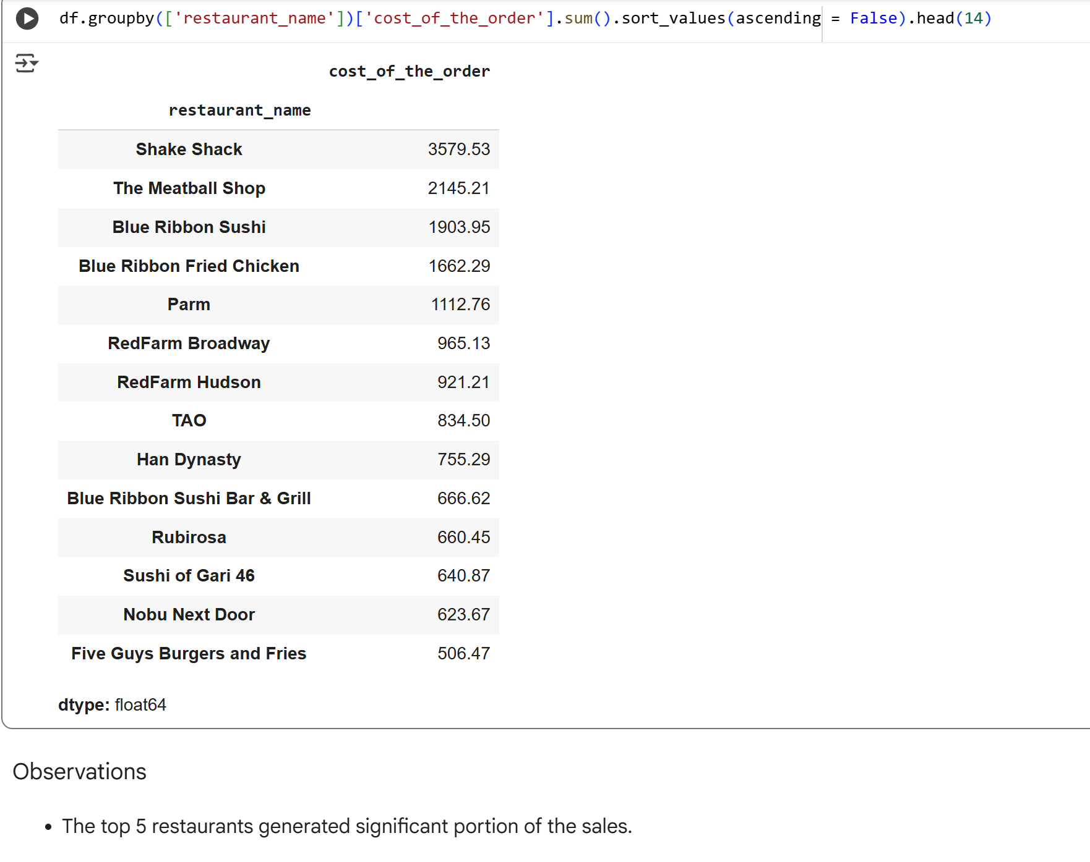

Slide 41
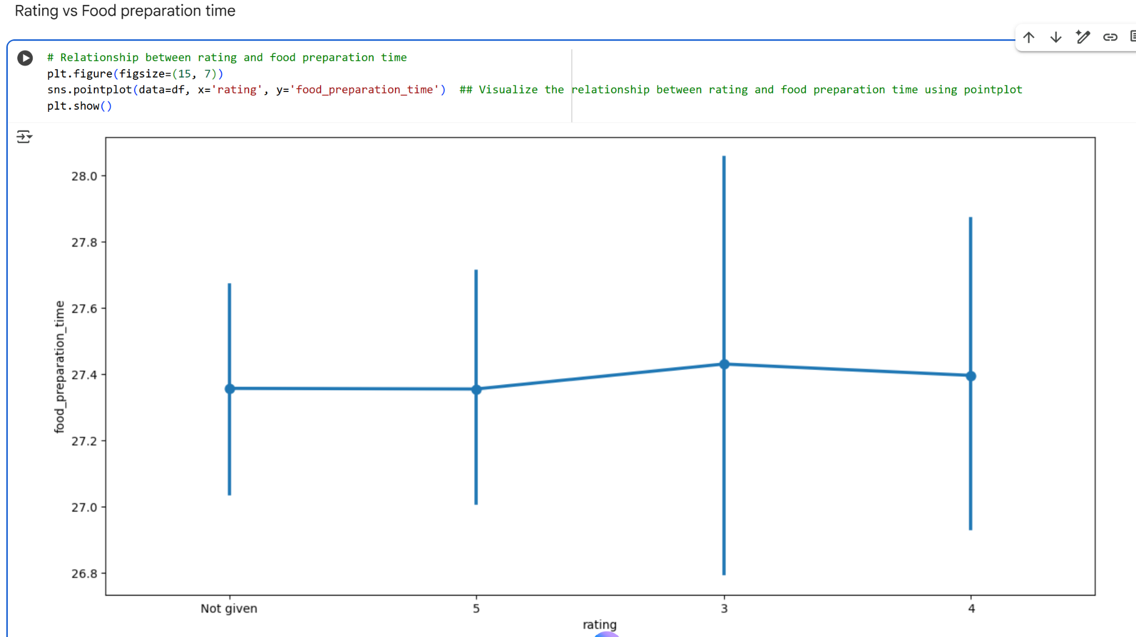

Slide 42
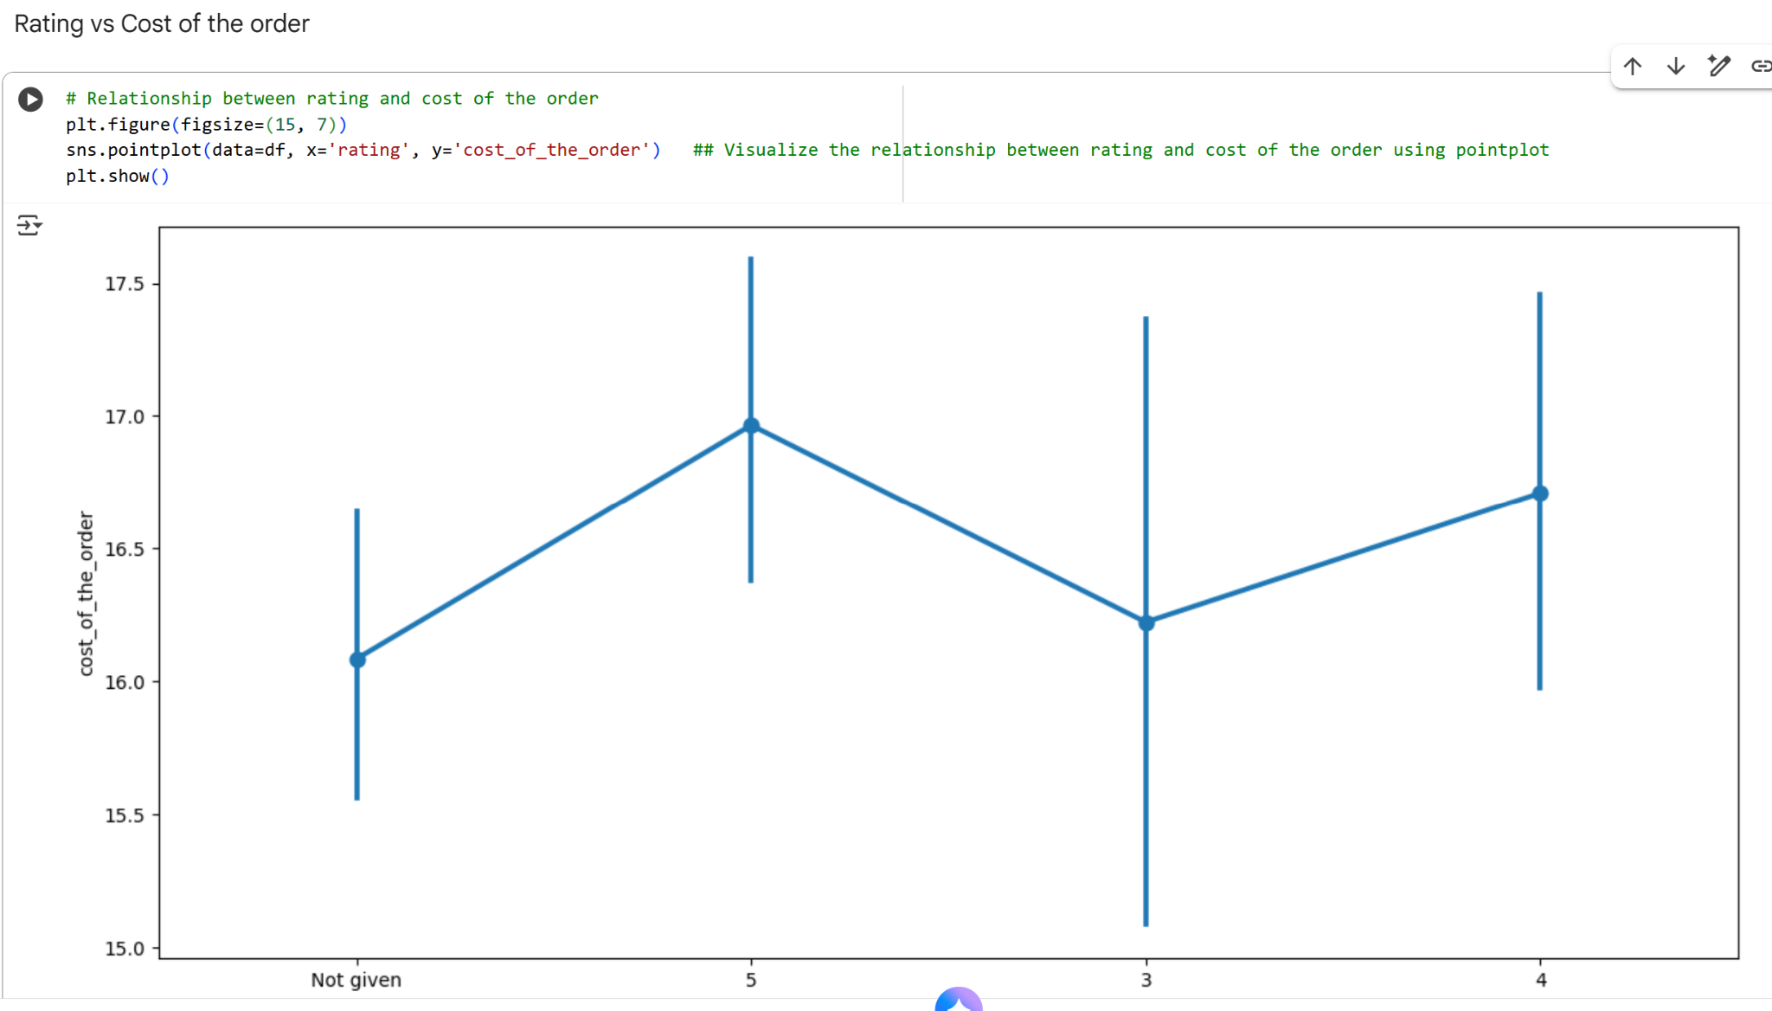

Slide 43
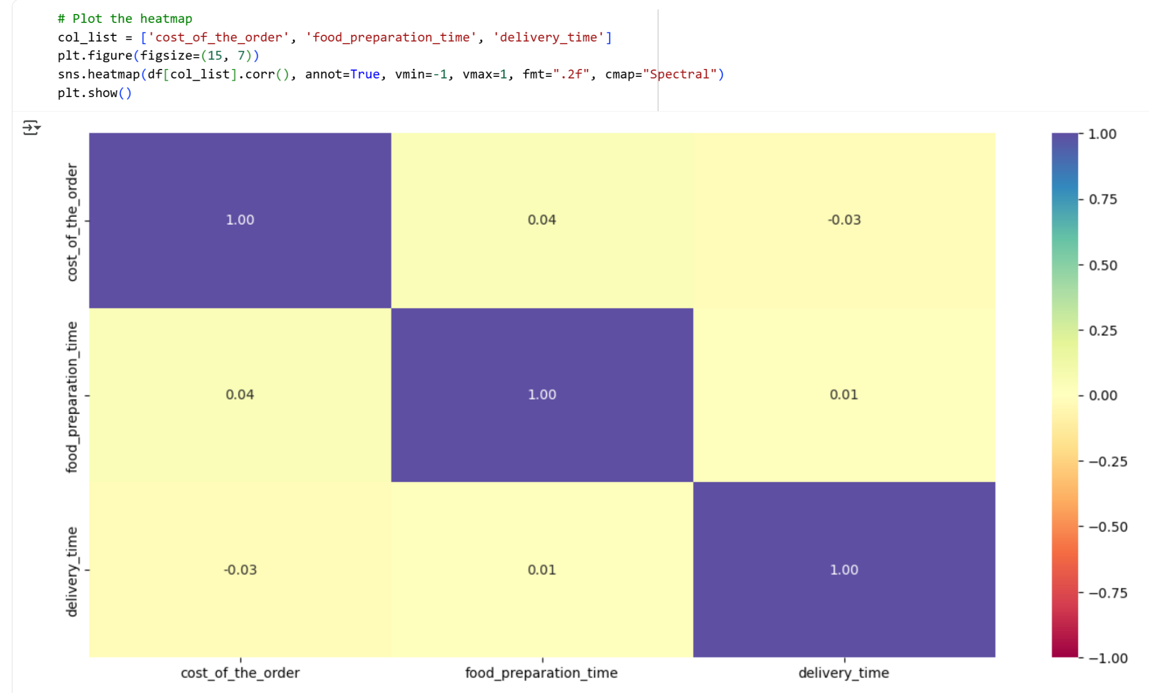

Slide 44
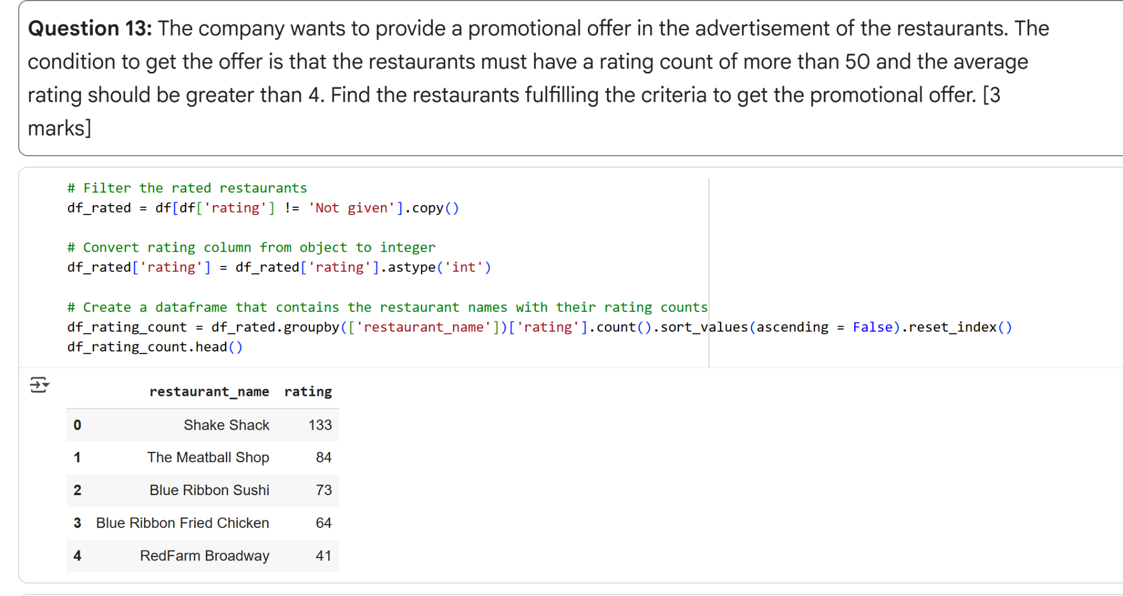

Slide 45
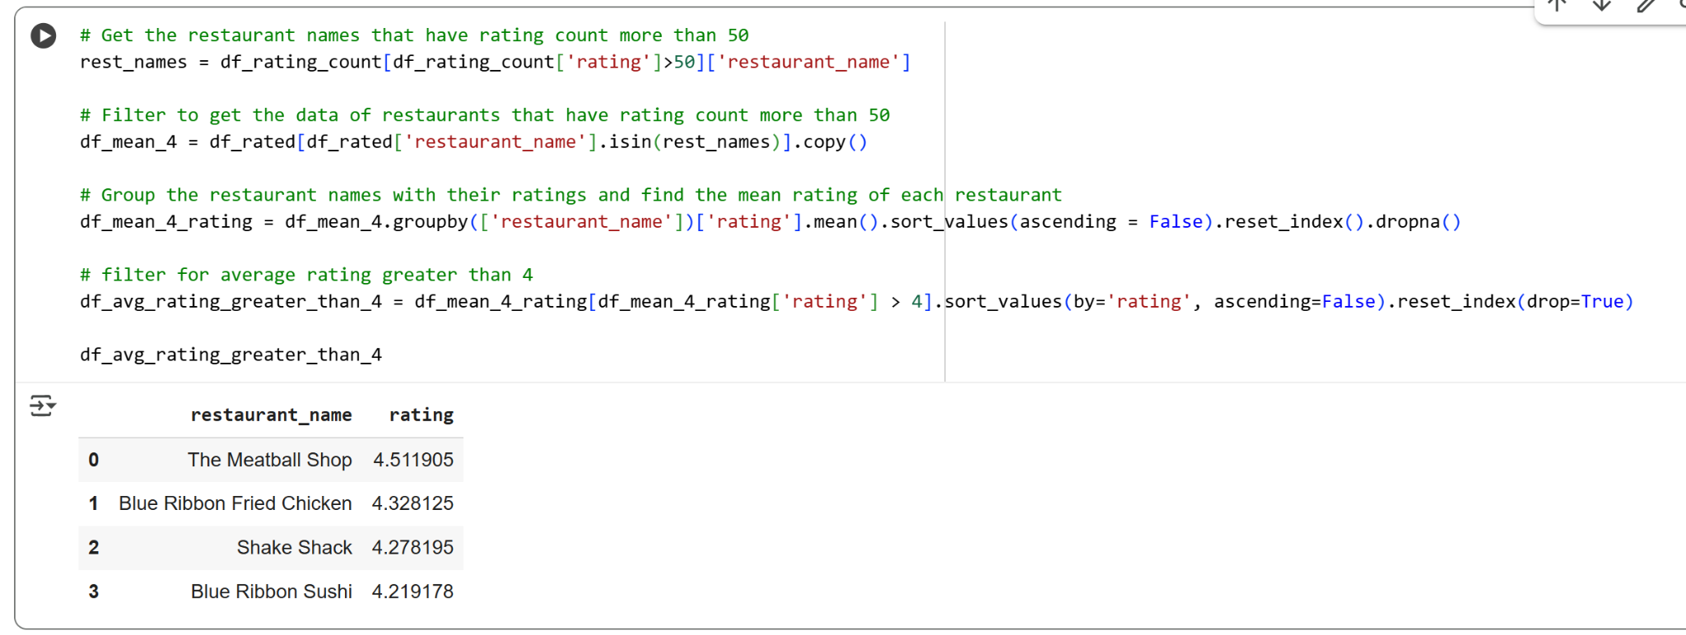

Slide 46
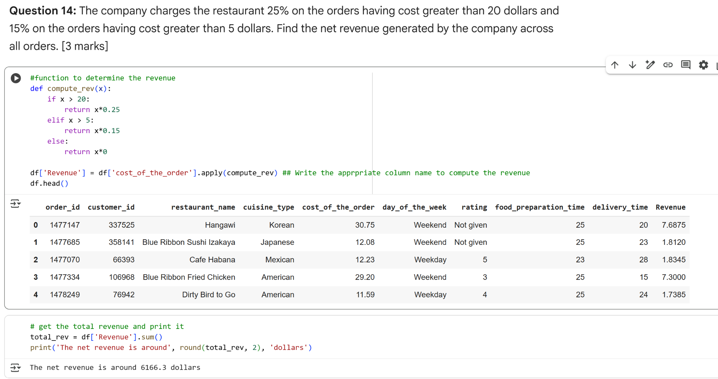

Slide 47
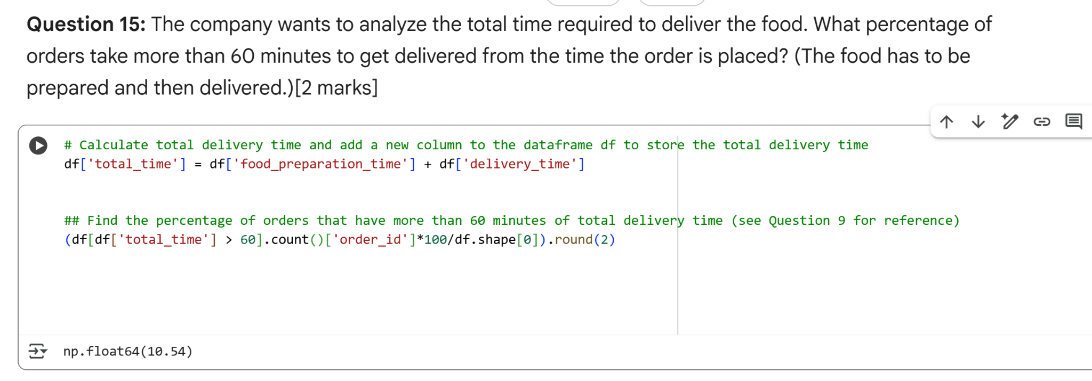

Slide 48
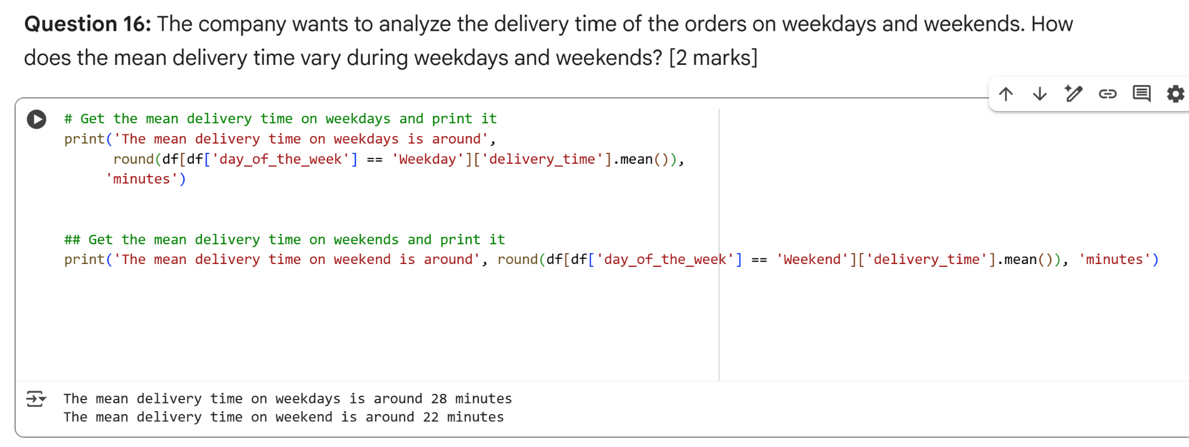

Slide 49
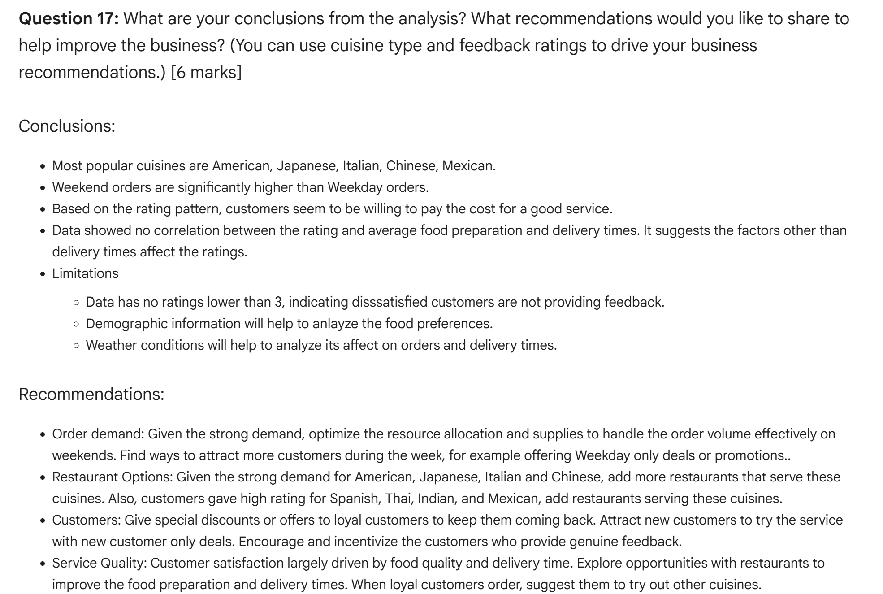

Slide 50
Slide Header
Please add any other pointers (if needed)

